Slide 1

Basic Introduction to Speckle Tracking Echocardiography
Mr Adrian Thomson
Notes:
Hello and welcome to this short presentation on Pre-Clinical Optical invivo imaging

Slide 2
Speckle Tracking Echocardiography
Speckle tracking is a method whereby speckle artefacts (small areas of higher echogenicity) within an ultrasound image are analysed.
By the tracking of speckles within the ventricle wall throughout the cardiac cycle information can be obtained on the motion vectors direction and velocity of displacement .
Comparing this motion of individual speckles to each other allows sensitive segmental or global deformation analysis of the myocardium i.e. magnitude and timing of when the myocardial expands (diastole) or contracts (systole).
Basic parameters Motion –Displacement / Velocity plus Deformation –Strain / Stain rate

Slide 3
Basic Parameters -Motion
Displacement and Velocity are vectors of Motion
Displacement is the vector change of position of an object in distance and direction measured in units of length. This distance from the starting position is not the same as distance travelled .
Velocity is a measurement of this displacement measured in units of length per time. A positive or negative sign specifies the direction

Slide 4
Basic Parameters -Deformation
Strain
Strain is the degree of deformation of an object i.e. Stretching , relative to its original length and is expressed in percent.
Strain can be Negative / shortening and positive / lengthening
View Longitudinal Radial Circumferential
Systolic -Shortening + Thickening - Shortening
Diastolic +Lengthening - Thinning +Lengthening
The force behind strain is called "stress". The relationship between stress and strain is the Cardio compliance (how easily a chamber of the heart expands when it is filled with a volume of blood).

Slide 5
Basic Parameters -Deformation
Strain Rate
Strain Rate is the rate of strain/deformation i.e. change in strain per time unit /s, or s⁻¹
An object can have the same strain, but different strain rate’s
A and B have the same positive strain.
The Strain rate of object A is higher than B
A
B

Slide 6
Basic Parameters - Motion and Deformation
A moving object does not undergo deformation if every part of the object moves with the same velocity e.g. a stiff (fibrotic) section of myocardium can still have motion due to tethering to surrounding healthy muscle , but not deformation.
If different parts of an object have different velocities, the object deforms i.e. changes shape
A-Object is moving with all parts at same velocity
-motion but no deformation
B- Object is moving with different parts having
different velocity's –differential motion and deformation
A
B
Further reading http://folk.ntnu.no/stoylen/strainrate/Basic_concepts.html

Slide 7
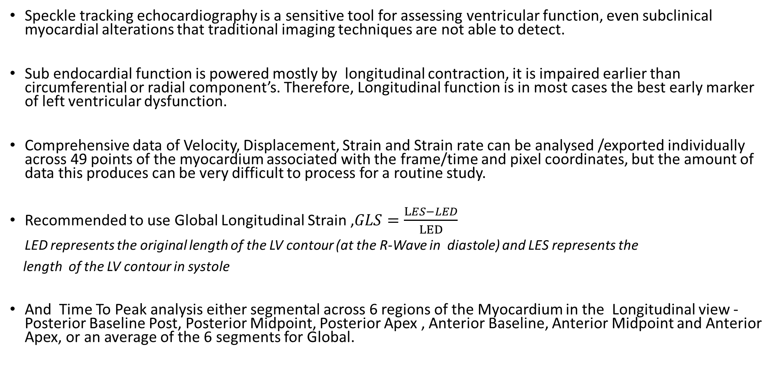
Assessing Cardiac Physiology
Speckle tracking echocardiography is a sensitive tool for assessing ventricular function, even subclinical myocardial alterations that traditional imaging techniques are not able to detect.
Sub endocardial function is powered mostly by longitudinal contraction, it is impaired earlier than circumferential or radial component’s. Therefore, Longitudinal function is in most cases the best early marker of left ventricular dysfunction.
Comprehensive data of Velocity, Displacement, Strain and Strain rate can be analysed /exported individually across 49 points of the myocardium associated with the frame/time and pixel coordinates, but the amount of data this produces can be very difficult to process for a routine study.
Recommended to use Global Longitudinal Strain ,$GLS=\frac{LES−LED}{LED}$
LED represents the original length of the LV contour (at the R-Wave in diastole) and LES represents the
length of the LV contour in systole
And Time To Peak analysis either segmental across 6 regions of the Myocardium in the Longitudinal view - Posterior Baseline Post, Posterior Midpoint, Posterior Apex , Anterior Baseline, Anterior Midpoint and Anterior Apex, or an average of the 6 segments for Global.

Slide 8

Assessing Cardiac Physiology
Systolic Assessment
Global Longitudinal Strain (GLS) , similar to EF as a functional measurement , but more reproducible and detects subclinical myocardial dysfunction before LVEF
Time to peak , segmental or the averaged global “longitudinal (peak systolic ) strain rate (LSR)” expressed in Pk 1/s , plus peak longitudinal strain expressed in “T2P ms” can both be used to assess subtle systolic changes that are not measurable with traditional volume cavity-based echocardiographic parameters e.g. ejection fraction (EF).
Negative strain in Longitudinal view
Clinical Example's include – Analysis of cardiac contractile dysfunction before the onset of myocardial hypertrophy, analysis of Myocardial dysfunction in Heart failure with preserved ejection fraction (HFpEF) conditions and Dilated cardiomyopathy (DCM)

Slide 9
Assessing Cardiac Physiology
Diastolic Assessment
Analysis of Diastolic dysfunction via mitral valve Doppler measurement’s of E A wave ,DT and IVRT is very challenging in adult mice , so it is possible to utilise the more robust alternative speckle derived measurement of Diastolic dysfunction .
In Time To Peak analysis, six segmental sections of the longitudinal Left ventricle ( anterior /posterior -Base, mid and apex) can be analysed for peak negative /diastolic strain rate , this is referred to as the reverse peak to differentiate from peak positive /systolic strain rate . The average of the six regional segments called “Reverse Longitudinal strain rate” (rLSR) is a sensitive global diastolic measurement.
Post. Base( )
Post. Mid
Post. Apex
Ant. Base
Ant. Mid
Ant. Apex
Average curve

Slide 10
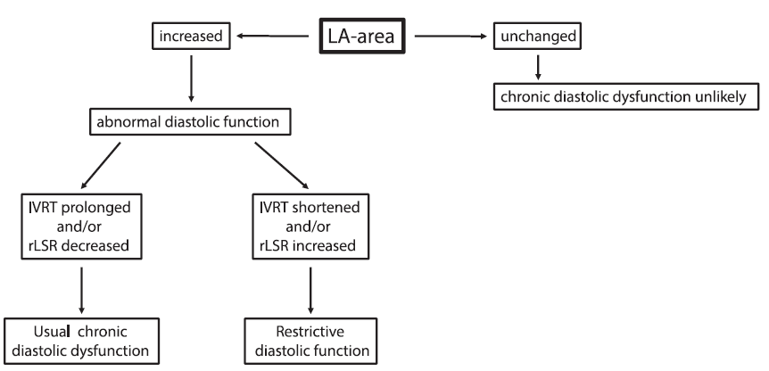
Assessing Cardiac Physiology
Diastolic Assessment
In the paper “Echocardiographic evaluation of diastolic function in mouse models of heart “ by Moritz Schnellea , Norman Catiboga and Ajay M Shah et al. , the algorithm below utilising rLSR in conjunction with left atrial size was proposed for assessment of LV diastolic dysfunction in mice can be applied to differentiate between chronic and restrictive diastolic dysfunction.
An increase in LV filling pressure restricts left atrial ventricular blood filling and can cause left atrial enlargement
https://www.jmmc-online.com/article/S0022-2828(17)30330-9/fulltext

Slide 11
Assessing Cardiac Physiology
Myocardial infarction (MI)/ischemia-reperfusion (IR) Assessment
Subtle systolic changes in deformation (strain), or strain rate (rate of deformation) can be analysed in regional segments to determine the level and degree of infarcted tissue or globally with GLS .
The standard deviation of time to peak longitudinal strain (T2P expressed in “ms”) across the 6 segment’s can be used to analyse dyssynchrony / mechanical dispersion , also maybe a useful measurement in dilated cardiomyopathy .

Slide 12
Speckle Tracking Echocardiography
Further reading http://folk.ntnu.no/stoylen/strainrate/Basic_concepts.html
Visualsonics Strain Tutorials
April 2015 Webinar - On Demand Tutorial: How to Measure Cardiac Wall Strain
https://www.youtube.com/watch?v=aC4dNaDh9og
Oct 2017 VevoStrain Webinar - Understanding Subtle Cardiac Changes
https://www.youtube.com/watch?v=qdr9Z0itTdo&t=2670s

