Slide 1
1
Deep Learning in Medical Imaging
Maria del C. Valdés Hernández
M.Valdes-Hernan@ed.ac.uk
Edinburgh Imaging Academy
University of Edinburgh

Slide 2
Overview
2
Human brain networks vs. artificial neural networks
Common types of neural networks
The maths behind
Some concepts – Cost function vs. activation function, gradient descend, backpropagation
Pre-processing – Selecting and preparing the inputs
Designing the network – filter (kernel) size, number of layers and units, stride, pooling parameters, cost & activation functions, regularisation type and batch size
Generative adversarial networks (GANs)
Validating the output
Summary
Notes:
This lecture will inform on the topics related on the screen.

Slide 3
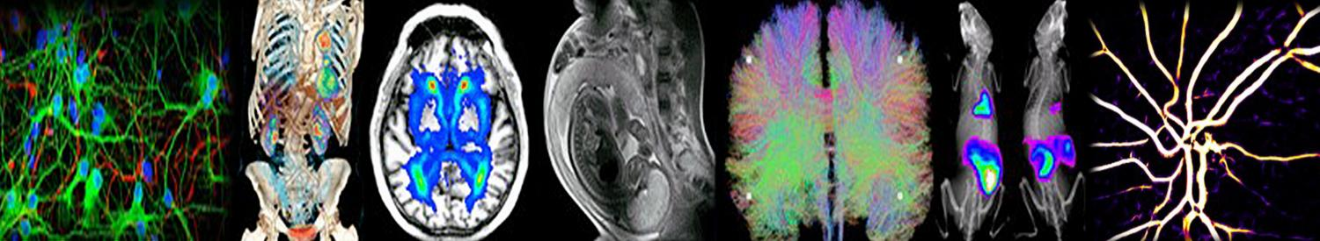
Overview
3
Edinburgh Imaging Academy programmes:
Imaging MSc/Dipl/Cert
Applied Medical Imaging Cert
Notes:
This lecture complements the contents of the imaging and Applied Medical Imaging MSc programmes within the Edinburgh Imaging Academy.
In a single lecture there is no time to go into a great level of detail on each of the topics we want to cover, but this lecture contains links to very good educational materials that hope will be very useful if you want to learn the topics covered.

Slide 4
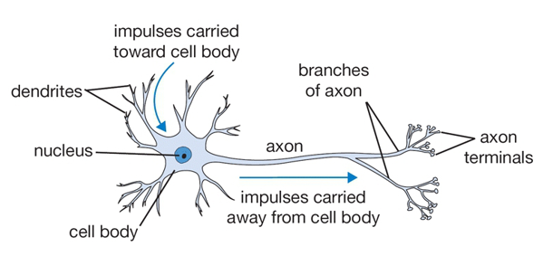
Human brain networks
4
The neuron as a “ computational” brain unit
https://cs231n.github.io/neural-networks-1/
~ 86 billion neurons → human brain
Notes:
The basic computational unit of the brain is a neuron. Approximately 86 billion neurons can be found in the human nervous system and they are connected with approximately 10^14 - 10^15 (one trillion) synapses.
The body of a neuron, called soma, is where most protein synthesis occur, and receives the “input” signals from the dendrites.
The axon carries the information to other neurons or to the body, and is protected by a layer of fat called myelin.

Slide 5
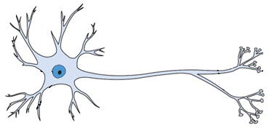
Human brain networks
5
Neural pathways formed by connected neurons enable signal transmissions throughout the brain
Notes:
Neurons connect to each other forming neural pathways like the one shown in this schematic representation.
In a neural pathway axons project from neurons to make synapses onto neurons in another location, enabling a signal to be sent from one region of the nervous system to another.
In these pathways, neurons are connected by a single axon, or by a bundle of axons known as a nerve tract, or fasciculus.
Shorter neural pathways are found within grey matter in the brain, whereas longer projections, made up of myelinated axons, constitute white matter.

Slide 6
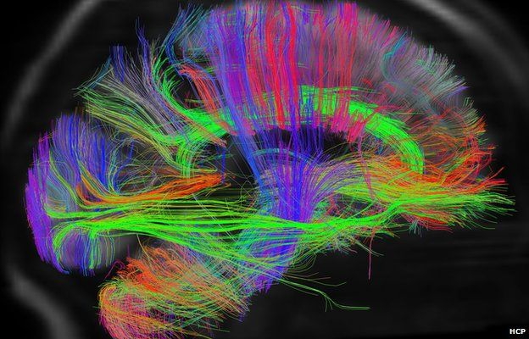
Human brain networks
6
Cingulum – emotion (ant) and memory (post)
Arcuate fasciculus – language and associated short-term memory
Uncinate fasciculus -language as well as episodic memory and social emotional processing
Inferior longitudinal fasciculus – visually guided behaviour
http://www.humanconnectomeproject.org/
Notes:
There is more still to be known than what we actually know about the brain. However, MRI, which basically images the water content in the part of the body that is examined, through a technique called “tractography” has been able to produce images of these brain networks as shown in the screen.
Networks with neurons connecting the posterior and anterior parts of the brain are visualized in green. Those connecting left and right sides of the brain in red, and those running from top to bottom are blue. Here we show the functionality in which some of these tract bundles or fasciculi intervene.
The inferior longitudinal fasciculus for example supports brain functions concerning the visual modality, including object, face and place processing, reading, lexical and semantic processing, emotion processing, and visual memory. Based on these findings it can be described as a multi-functional white matter pathway involved in visually guided behavior.

Slide 7
Human brain networks
7
Corpus callosum – interhemispheral connections
Cerebellar tracts (various) – involuntary movements
Corticospinal tract – senses and motion
http://www.humanconnectomeproject.org/
Notes:
While the cerebellar tracts are involved in involuntary movements, the corpus callosum contains the tracts that connect both cerebral hemispheres.
The corticospinal tract is a white matter motor pathway starting at the cerebral cortex that terminates on lower motor neurons and interneurons in the spinal cord, controlling movements of the limbs and trunk

Slide 8

Human brain networks
8
BRAIN POWER: From Neurons to Networks (10.46 mins)
BBC Science Documentary | Human Brain How smart can we get (52.42 mins)
NOVA SCIENCE NOW - HOW THE BRAIN WORKS - PBS NOVA DOCUMENTARY (1h 26.38 mins)
http://www.humanconnectomeproject.org/
Notes:
From all educational videos about brain networks and functions we have selected 3 with different duration that hope you find them useful and informative.

Slide 9
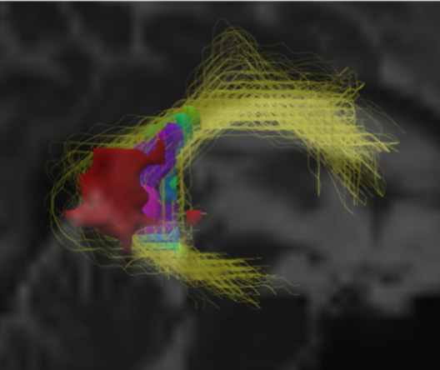
Human brain networks
9
When something goes wrong somewhere
Damage may either propagate along the tracts or accumulate prompting re-routing of the signal transmission reflecting in different patterns of cortical activation
doi: 10.3389/fneur.2019.00784/full
Notes:
The figure shows a 3D representation of a brain lesion affecting the arcuate fasciculus, a white matter tract shown previously. When this occurs, damage may either propagate along the tracts or accumulate prompting re-routing of the signal transmission reflecting in different patterns of cortical activation.

Slide 10
Machine learning
10
Machine Learning
Supervised Learning
Unsupervised Learning
Predictive models based on existing input and output data
Group and interpret input data
https://www.coursera.org/learn/machine-learning
https://www.coursera.org/learn/uol-machine-learning-for-all
Notes:
Mankind has always dreamt to emulate the brain functioning and its capacity to learn and act from result of this learning process.
Several algorithms have been developed that adaptively optimize their parameters by reducing the error in generating a correct output, developing a whole field that has been known as machine learning. The way they perform these optimization tasks have prompted their classification into supervised and unsupervised. Supervised models give a predictive response based on existing input and output data previously collected and annotated by experts. For example, regression models like general linear models (GLM), support vector regression, decision trees and neural networks, and classification models like support vector machine (SVM), the nearest neighbor algorithm, and large margin classifiers.
Unsupervised models group and interpret output data using inference rules. For example clustering algorithms like k-means, fuzzy C-means, Gaussian mixture models, and minimum variance quantization.

Slide 11
Artificial neural networks
11
Notes:
This lecture will concentrate in artificial neural networks, as previously mentioned, supervised machine learning algorithms. For explaining their principles, let’s talk about our own brain networks. Going back to our previous diagram of interconnected neurons…

Slide 12
Artificial neural networks
12
Notes:
Substituting the body of each neuron or processing unit by a circle, and the axon and dendrite bundles by arrows…

Slide 13
Artificial neural networks
13
Input layer
Output layer
Hidden layer
https://www.coursera.org/learn/neural-networks-deep-learning
Notes:
We have the basic diagram of an artificial neural network with three layers: the input layer, the hidden layer and the output layer.

Slide 14
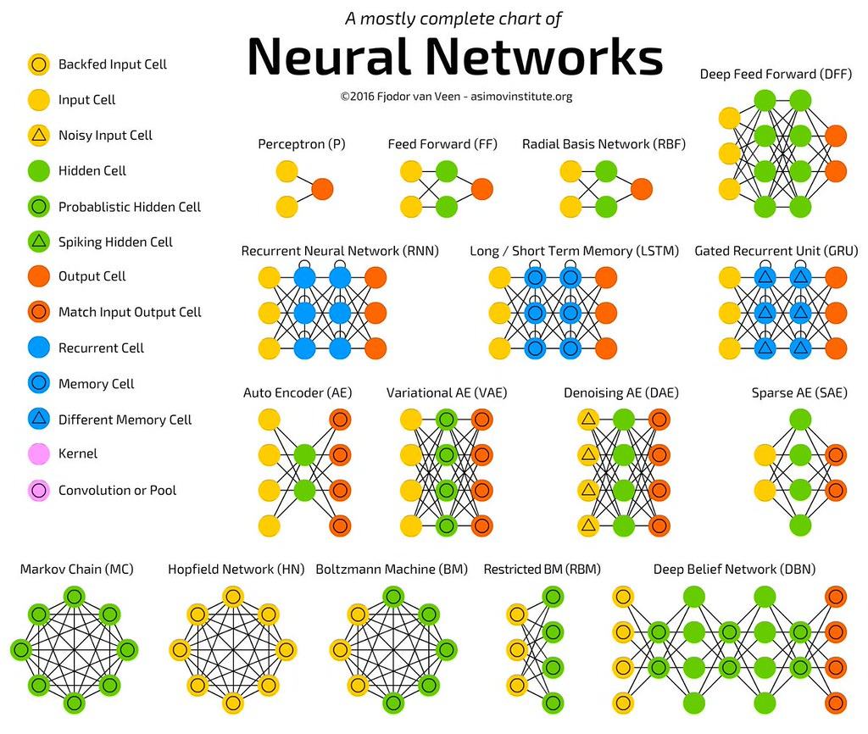
Types of artificial neural networks
14
https://farm5.staticflickr.com/4312/36277127256_ef47e670fb_b.jpg
Notes:
But there are several modifications of this basic scheme that have evolved in different types of neural networks with different functionalities and advantages for their application under certain conditions and for a different tasks. The figure on the screen shows a comprehensive summary of them. We will only explain briefly few of the most relevant for structural image analysis; the first one being the radial basis network.

Slide 15
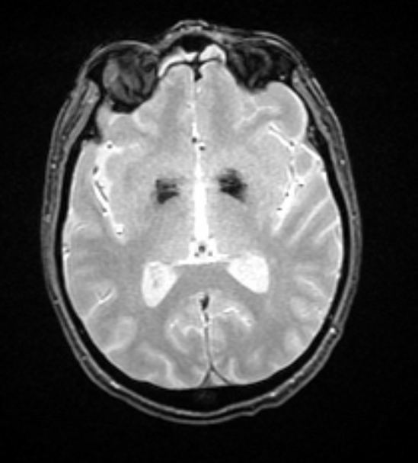
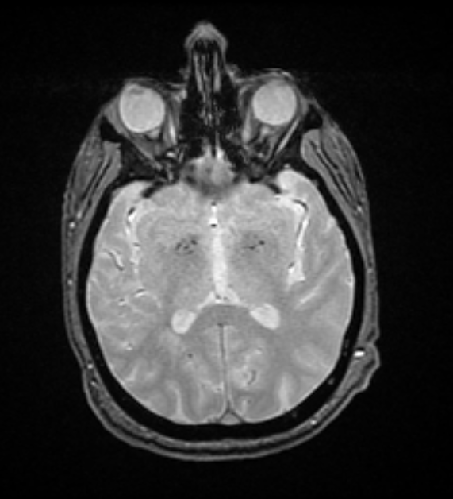
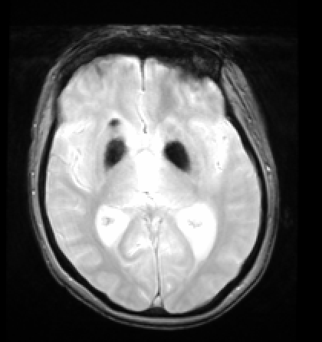

Radial Basis Network
15
distance
Radial basis functions in their hidden layer
e.g. Gaussian Radial function:
f(r) = exp(-r²/2c²)
See examples in MATLAB here
e.g. Segmentation of microbleeds
Notes:
You certainly have seen this diagrams so many times. It shows a feature from two classes of objects mapped in a Cartesian coordinates 2D space. The line dividing the two classes in the space represents the response of the algorithm to the task of finding the boundary between the 2 subspaces in which we are most likely to find “objects belonging to each class.
[click]
But what about now? The subspace have been divided differently. In this case both solutions are appropriate. But there are cases in which our second solution might produce more accurate response.
[click]
This would be the case of a network for example aimed at identifying and segmenting microbleeds. As you can see from this image, although microbleeds are hypointense as the basal ganglia mineral deposition in the two examples at each side, and located in the same area, they can be distinguishable.
[click]
A radial basis finction network differs from the common feed-forward back-propagation network in the use of radial basis functions as activation functions in their hidden layer. In a radial basis finction we define a receptor and draw confrontal maps around the receptor. One popular choice is the Gaussian kernel, which uses the squared distance from a vector r to the centre c to assign a weight. The equation shown represents a probability density function of features distributed normally.
Examples in Matlab can see clicking on the link.

Slide 16
Types of artificial neural networks
16
https://farm5.staticflickr.com/4312/36277127256_ef47e670fb_b.jpg
Notes:
The other group of neural networks that have been used in medical image processing tasks, especially for longitudinal analyses are the recurrent neural networks, where each neuron or unit can use its internal memory to maintain information about the previous input, allowing it to exhibit temporal dynamic behaviour.

Slide 17
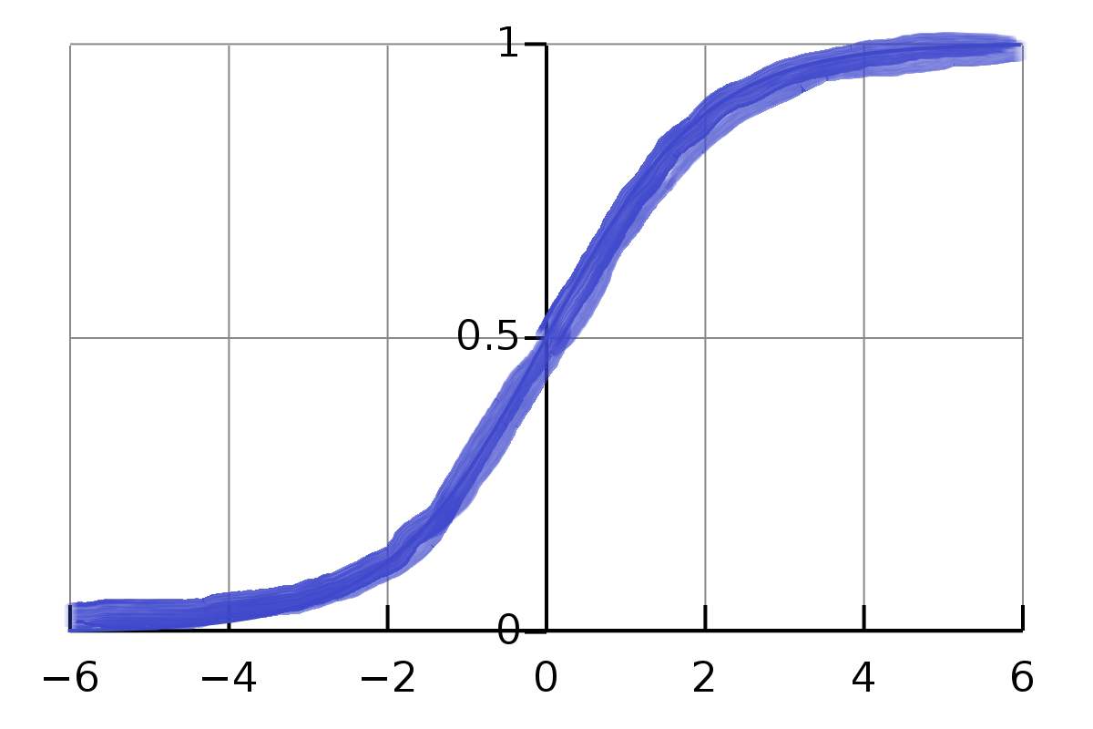
Recurrent Neural Networks
17
LSTM
o_{t}
i_{t}
x_{t}
c_{t0}
f_{t}
X_{t-1}
Network connections form a graph along a temporal sequence → temporal dynamic behaviour.
Can use their internal state (memory) to process sequences of inputs of variable lengths
MATLAB trained RNN for use in classification problems can be seen here
Recurrent Neural Networks Medium post for more insights
Notes:
The Long-short term memory LSTM is one type of recurrent neural network that is relatively insensitive to gap lengths in the sequence, and commonlyis ccomposed of cells with 3 “regulators”: input gate, output gate and forget gate. They commonly use the logistic sigmoid function as activation function although the hyperbolic tangent function has also been used. This is to compute an activation of a weighted sum that considers the activation of the memory cell at t-1.
The diagram on the screen shows 2 LSTM layers. Many applications use stacks of LSTM layers and train the networks ny connectionist temporal classification.

Slide 18
Types of artificial neural networks
18
https://farm5.staticflickr.com/4312/36277127256_ef47e670fb_b.jpg
Notes:
The last family of neural networks we will briefly introduce are the autoencoders. The autoencoders learn a representation for a set of data by raining the network to ignore signal noise. Then, for example, if we train them with images that do not have lesions, they would be supposed to recognise the lesions when they appear, by subtracting the original image from the “clean” output.

Slide 19
Artificial neural networks
19
Encoder
Decoder
Notes:
Autoencoders have similar architecture to the basic scheme we have seen, in which the learning or training sees the output layer to have the same (or lt least the same nature of) information as the input so as the network learns the characterisics of the input.

Slide 20
Artificial neural networks
20
But what is a Neural Network? | Deep learning, chapter 1
Notes:
Let’s explain now the maths behind this learning process.
(indicate the link)

Slide 21
Artificial neural networks
21
f
w₁₁
fX₁w₁₁+fX₂w₂₁
X₁
W’₁₁
Y₁
w₁₂
W’₂₁
w₂₁
f
W’₃₁
w₂₂
fX₁w₁₂+fX₂w₂₂
X₂
W’₂₂
W’₁₂
Y₂
w₂₃
w₁₃
… + b_{i}
f
W’₃₂
fX₁w₁₃+fX₂w₂₃
Y₁ = f(X₁w₁₁+X₂w₂₁)W’₁₁+f(X₁w₁₂+X₂w₂₂)W’₂₁+f(X₁w₁₃+X₂w₂₃)W’₃₁
Y₂ = f(X₁w₁₁+X₂w₂₁)W’₁₂+f(X₁w₁₂+X₂w₂₂)W’₂₂+f(X₁w₁₃+X₂w₂₃)W’₃₂

Slide 22

Overview
22
Human brain networks vs. artificial neural networks
Common types of neural networks
The maths behind
Some concepts – Cost function vs. activation function, gradient descend, backpropagation

Slide 23
Artificial neural networks
23
f
Activation
function
w₁₁
X₁
W’₁₁
Y₁
w₁₂
W’₂₁
w₂₁
f
W’₃₁
w₂₂
W’₂₂
X₂
W’₁₂
Y₂
w₂₃
w₁₃
… + b_{i}
f
W’₃₂
Y₁ = f(X₁w₁₁+X₂w₂₁)W’₁₁+f(X₁w₁₂+X₂w₂₂)W’₂₁+f(X₁w₁₃+X₂w₂₃)W’₃₁
Y₂ = f(X₁w₁₁+X₂w₂₁)W’₁₂+f(X₁w₁₂+X₂w₂₂)W’₂₂+f(X₁w₁₃+X₂w₂₃)W’₃₂

Slide 24
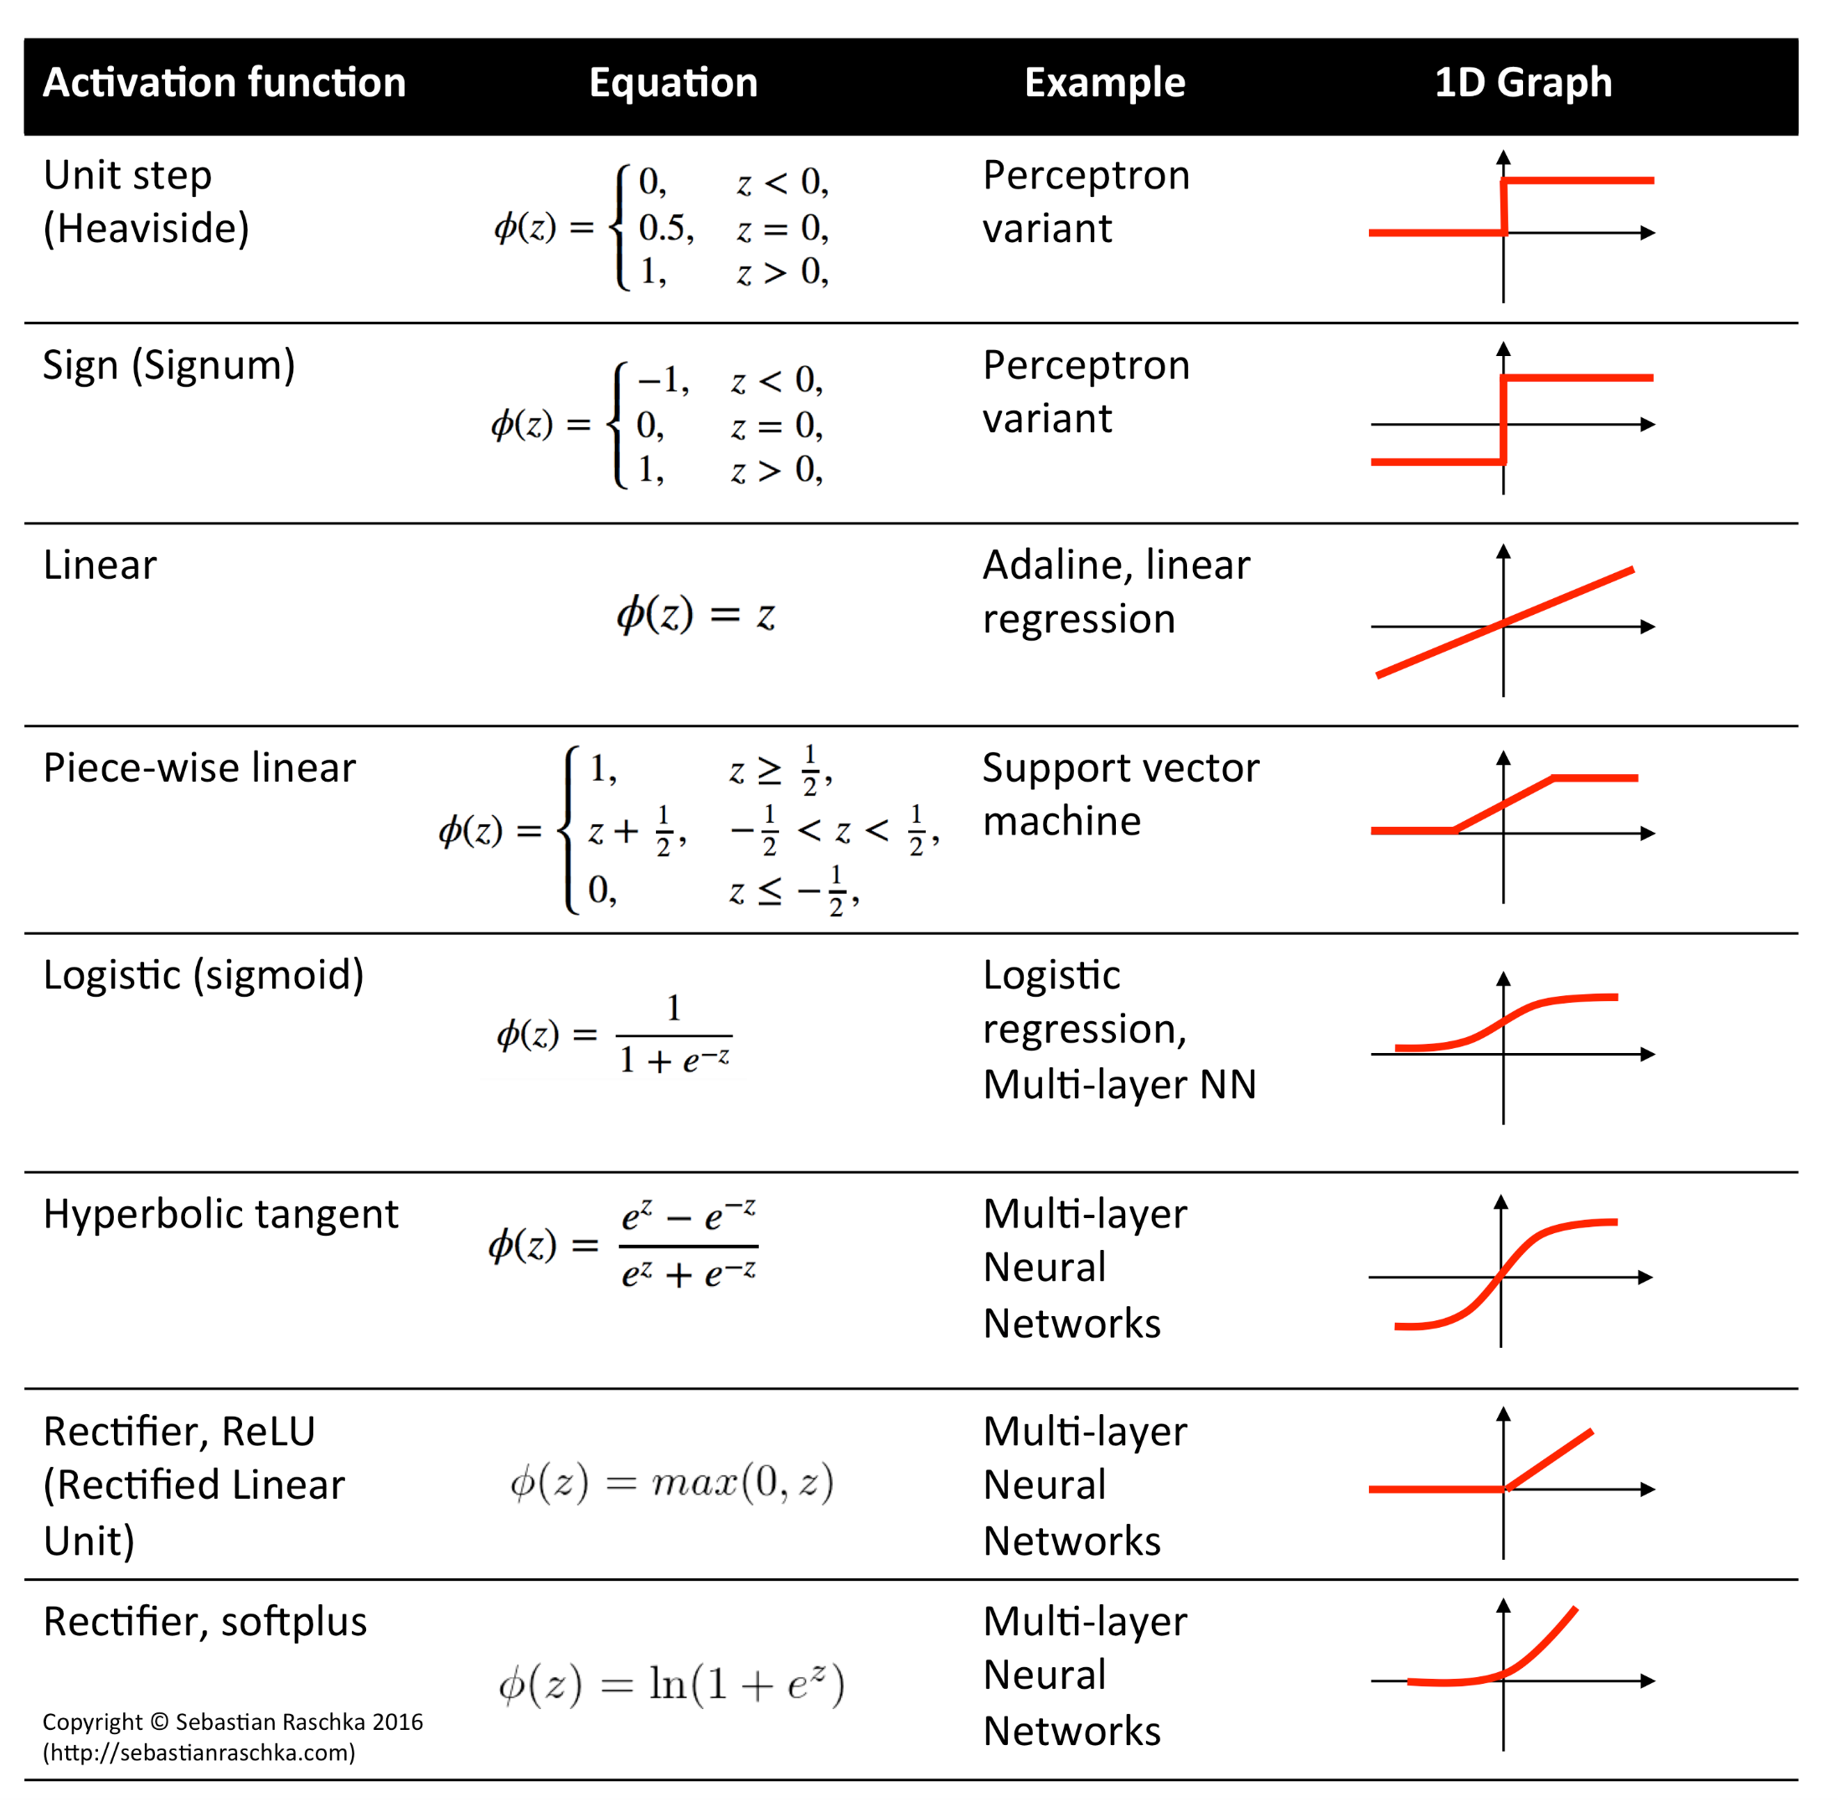
Activation functions
24
https://rasbt.github.io/mlxtend/user_guide/general_concepts/activation-functions_files/activation-functions.png
Notes:
The activation function decides whether or not and how a neuron should be activated.
The sigmoid function has been historically used since it is a nice interpretation on how a neuron really works. But it has 2 major limitations:
Sigmoids saturate and kill gradients. If the local gradient is very small, almost no signal will flow to its weights and recursively to its data. Also, when weights are too large, they can saturate the neuron’s output.
Sigmoid outputs are not zero-centered having implications on the dynamics during adjusting the weights in the back-propagation because gradient updates can be zig-zagging.
The hyperbolic tangent function is a scaled sigmoid function but zero centered.
The ReLU function has become more popular recently. It has pros and cons. The pros are: 1) It accelerates the convergence of the gradient descends compared to the sigmoid function, and 2) It is inexpensive as it can be implemented by simply thresholding a matrix of activations at zero. The cons is that it can die during training if the learning rate is set too high (observe the output is zero for x<0)

Slide 25
Convolutional neural networks (CNNs)
25
…
…
…
…
…
Feature learning
(convolutional layers)
Segmentation/classification
How Deep Neural Networks work (24.37 mins)
How Convolutional Neural Networks work (26.13 mins)
Notes:
The screen shows a representation of the principle of convolutional neural networks (CNNs). They take their name due to the presence of stacked layers of filters that capture image features using a mathematical operation called convolution.
CNNs are defined in the literature as multi-layered neural networks with a unique architecture designed to extract increasingly complex features of the data at each layer to determine the output. CNNs are well suited for perceptual tasks.
But why to use CNNs? Why these filters and layers are necessary?

Slide 26
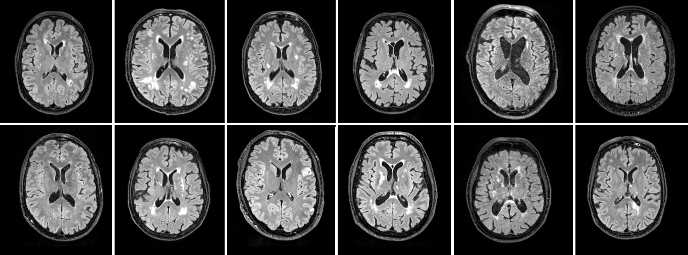
Things to address
26
Notes:
The screen shows the equivalent FLAIR axial slice from MRI scans from 12 different people who suffered a mild-to-moderate stroke. As can be appreciated, there is so much heterogeneity in the shape of the brains and in the location, size and appearance of the lesions.

Slide 27
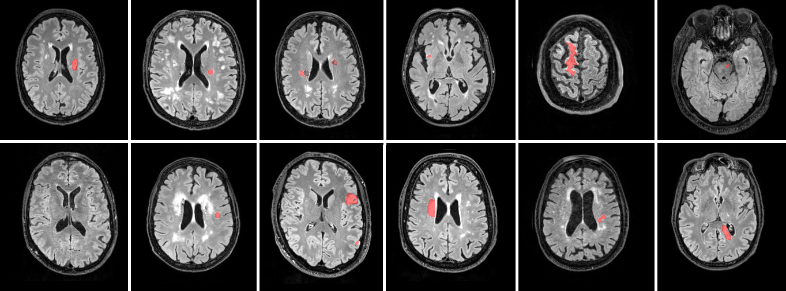
Things to address
27
Notes:
Here are highlighted (masked in red) the stroke lesions from these 12 scans. Any new scan will be different. The algorithm needs to regularize the common features of all these scans and be able to identify features that allow the recognition of the stroke.
The convolutional layers, by applying filters to input images, create feature maps that summarise these features in the input. Layers close to the input learn low-level features (e.g. lines and corners), and layers deeper in the model learn more abstract-like features like shapes or specific objects.
But small movements in the position of the features will result in a different feature map. A common approach to solve this is downsampling. We will see how this can be achieved.

Slide 28

Things to address
28
Ground truth
Quantitative Comparison of 21 Protocols for Labeling Hippocampal Subfields and Parahippocampal Subregions in In Vivo MRI: Towards a Harmonized Segmentation Protocol
Notes:
Another important thing to address is the ground truth. Click on the link and analyse the paper.

Slide 29
Pre-processing
29
Image coarse alignment
Selection of the Region of Interest (ROI)
Refinement of the image alignment
Construction of the data input array
Preparation of the ground truth
Notes:
The CNN is a smart solution, but we need to help it by preprocessing the input and preparing the ground truth. Here are the steps we do. Let’s see each of them in more detail.

Slide 30
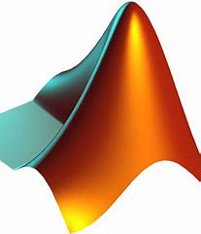
Registration – code example
30
%This code registers two MRI sequences, namely T2-weighted images to T1-weighted images in 3 datasets
folders = { [‘path1’,filesep,‘T1W_1’], [‘path1’,filesep,‘T2W_1’];
[‘path2’,filesep,‘T1W_2’], [‘path2’,filesep,’T2W_2’];
[‘path3’, filesep,‘T1W_3’], [‘path3’,filesep,‘T2W_3’]};
num_datasets = length(folders);
path4results = [‘..’,filesep,’test’,filesep];
Impractical for thousands of images
for i=1:num_datasets % Start the loop
display (['current session is: ',num2str(i)]);
% Direct registration to T1W using FSL-FLIRT
system ([‘flirt -in ‘,folders{i,2},’ -ref ‘,folders{i,1},’ -out ‘,path4results, ’T2WregT1W_’,num2str(i),’ -dof 6’]);
end % end of the loop
Coarse. Better alignment is achieved if the brain (i.e. ROI) is segmented first

Slide 31
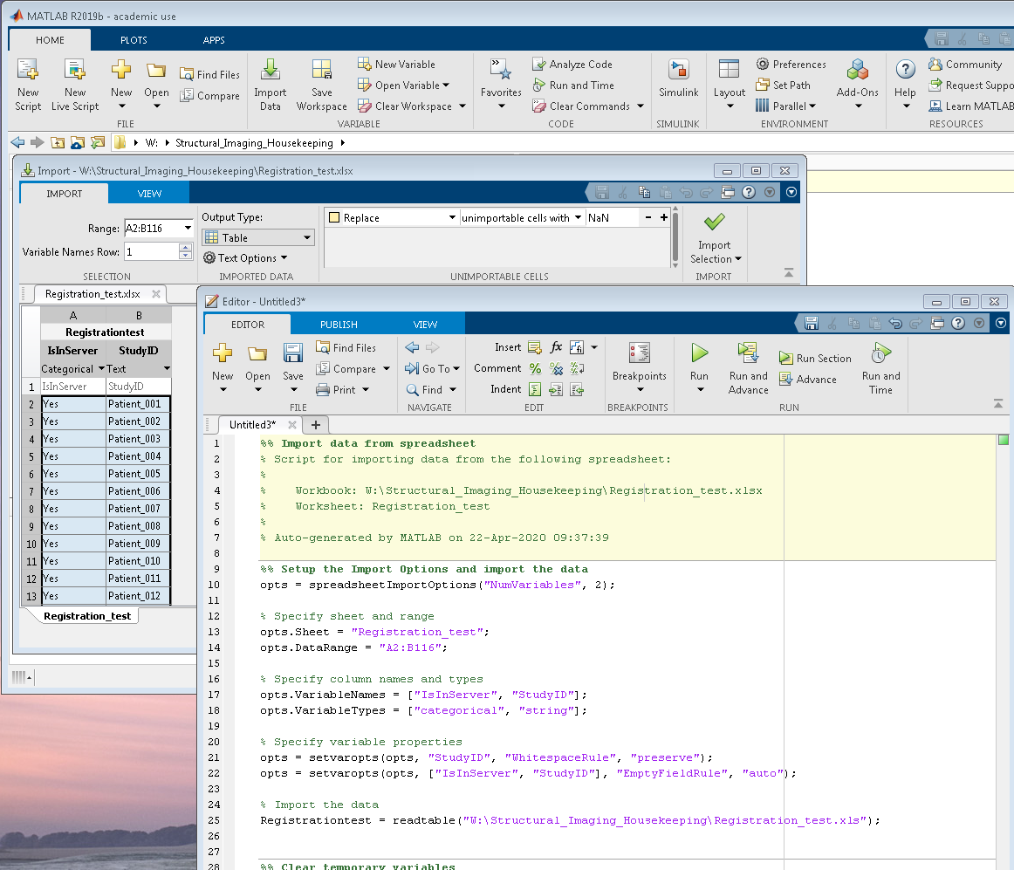
Registration – code example
31

Slide 32
ROI extraction – Brain extraction example
32
NIFTI - Tools for NIfTI and ANALYZE image (by J Shen)
FMRIB Software Library (FSL)
BRIClib
bric_bet_GRE
GRE only
GRE and T2W
GRE and FLAIR
Bias field correction (FSL-FAST)
fast <-b –B>
Weighted sum of adjusted
aligned images (if applicable)
FSL-Brain Extraction Tool (bet2 <-m>)
Standardise intensities (z-scores),
thresholding, fill holes

Slide 33
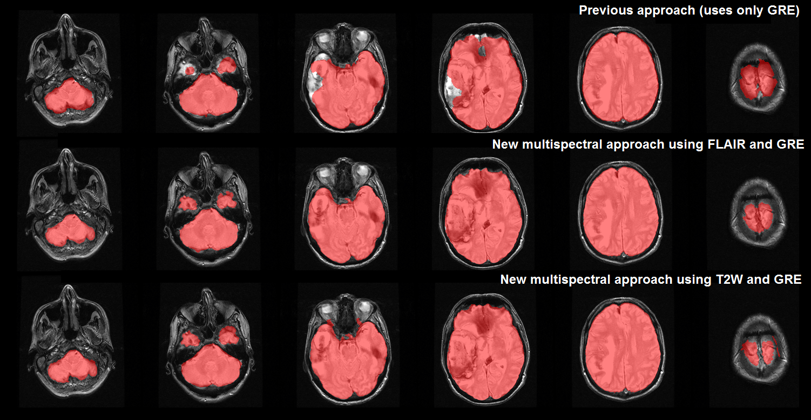
ROI extraction – Brain extraction example
33
NIFTI - Tools for NIfTI and ANALYZE image (by J Shen)
FMRIB Software Library (FSL)
BRIClib
bric_bet_GRE

Slide 34
ROI extraction – Brain extraction example
34
NIFTI - Tools for NIfTI and ANALYZE image (by J Shen)
FMRIB Software Library (FSL)
BRIClib
bric_bet_GRE, bric_bet_T1WT2W
T1W and T2W
Bias field correction (FSL-FAST)
fast <-b –B>
Co-register images if not aligned
and take coordinates (c) of shift from
centre space (q-offset)
FSL-Brain Extraction Tool in 2 steps:
bet2 <-m -f -c -R>
and
bet2 <-c -A2>

Slide 35
ROI extraction – Brain extraction example
35
NIFTI - Tools for NIfTI and ANALYZE image (by J Shen)
FMRIB Software Library (FSL)
BRIClib
bric_bet_GRE, bric_bet_T1WT2W, bric_bet_PD
PD
Bias field correction (FSL-FAST)
fast <-b –B>
FSL-Brain Extraction Tool
bet2 <-m -v -f -g >
(f = 0.4, g = 0)

Slide 36
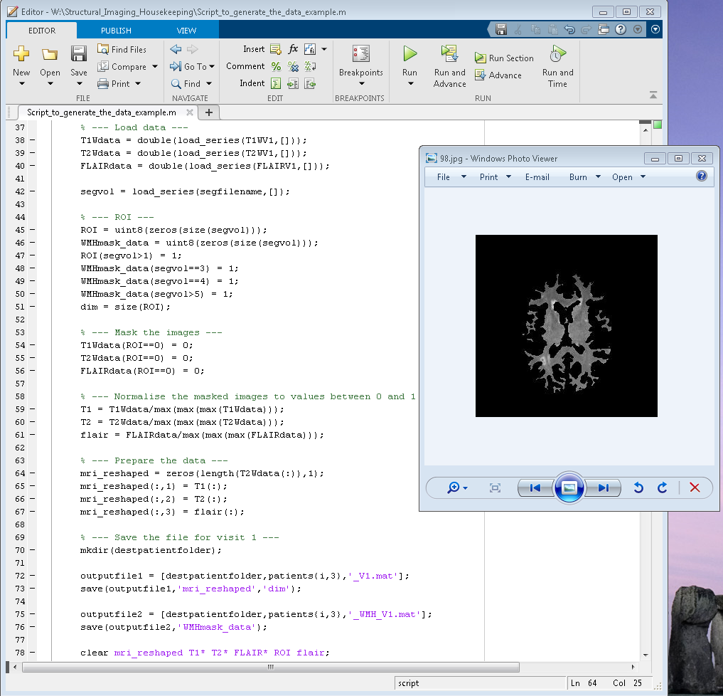
Construction of the data input array
36
Sparse data
https://sourceforge.net/projects/bric1936/files/MATLAB_R2015a_to_R2017b/BRIClib/

Slide 37
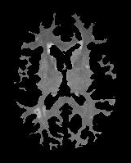
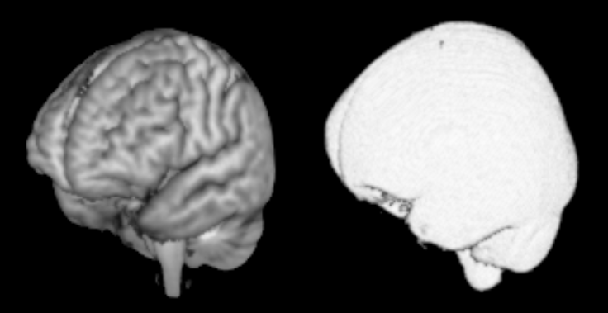
But we have several images
37
Template binary mask (ICV in this case)
Cohort (or age and disease relevant) template

Slide 38
… all together in a 4D volume
38
ICVtemplate = './Project_folder/Age_and_disease_relevant_template’;
ICVdata = load_series(ICVtemplate,[]);
ICVdatabin = logical(ICVdata);
ROI = regionprops(ICVdatabin,'BoundingBox');
allBoundingBoxes = [ROI.BoundingBox];
x1 = allBoundingBoxes(1:6:end);
x2 = allBoundingBoxes(1:6:end) + allBoundingBoxes(4:6:end);
y1 = allBoundingBoxes(2:6:end);
y2 = allBoundingBoxes(2:6:end) + allBoundingBoxes(5:6:end);
z1 = allBoundingBoxes(3:6:end);
z2 = allBoundingBoxes(3:6:end) + allBoundingBoxes(6:6:end);
xLeft = floor(min(x1))+1; % Get the overall bounds
xRight = ceil(max(x2))-1;
yLeft = floor(min(y1))+1;
yRight = ceil(max(y2))-1;
zLeft = floor(min(z1))+1;
zRight = ceil(max(z2))-1;
croppedICV = ICVdata(yLeft : yRight, xLeft : xRight, zLeft: zRight);
WMarray = double(zeros([size(croppedICV),numpatients]));
Gives a struct containing a row vector of
dims 1x6 with the coordinates of the upper
left front corner and width of the cuboid
regionprops3 gives the same info but in a table

Slide 39
… all together in a 4D volume
39
for i=1:numpatients
WM_stdspace = [inputfolder,patients{i},'_WM_stdspace‘];
WMdata = load_series(WM_stdspace,[]);
WMarray(:,:,:,i) = WMdata(yLeft : yRight, xLeft : xRight, zLeft : zRight);
end
save([outputfolder,'WM_4D_cropped.mat‘],'croppedICV‘,'allBoundingBoxes‘,'ICVdata‘,…
'ICVdatabin‘,‘ROI‘,'WMarray‘,'WMdata‘,'x1‘,'x2‘,'y1‘,'y2‘,'z1‘,'z2‘,'xLeft‘, xRight‘,…
'yLeft‘,'yRight‘,'zLeft‘,'zRight‘);
4D volume

Slide 40
Designing a CNN
40
Why haven’t been already designed automatically?
Too many hyperparameters
Infinitely many ways to design a network for the many different purposes
What does a CNN design involves?
Human expertise
Trial and error
Large training sets
Pre-processing inputs
Reliable ground truth
Don’t design: use a workable network and/or modify it

Slide 41

Designing a CNN
41
Popular designs already applied to Medical Imaging
UNet Biomedical Image Segmentation
UResNet Lesion Segmentation and Classification
DeepMedic Lesion Segmentation
AlexNet Biomedical Image Segmentation
Notes:
MATLAB can import libraries and networks from Python, Python can deploy MATLAB programs and both can share (transfer and store) data

Slide 42
42
Calling functions and objects from Python in MATLAB
Install CPython (versions 2.7, 3.6 or 3.7)
To call a Python function type py. in front of the module/function name
For passing parameters to Python functions it is straightforward unless they require a keyword (precede them with pyargs)
https://uk.mathworks.com/help/matlab/calling-python-functions.html

Slide 43
43
Import Deep Learning models from Python to MATLAB and viceversa
Convert the model to the Open Neural Network Exchange (ONNX) format (see tutorials here)
Convert from ONNX format to the desired framework or deploy it for different platforms using runtimes designed to accelerate inferencing (see tutorials here)
See list of supported ONNX tools here

Slide 44
Designing a CNN
44
Pre-trained models already available in MATLAB
Network | Depth | Size | Parameters (Millions) | Image Input Size
squeezenet | 18 | 4.6 MB | 1.24 | 227-by-227
googlenet | 22 | 27 MB | 7.0 | 224-by-224
inceptionv3 | 48 | 89 MB | 23.9 | 299-by-299
densenet201 | 201 | 77 MB | 20.0 | 224-by-224
mobilenetv2 | 53 | 13 MB | 3.5 | 224-by-224
resnet18 | 18 | 44 MB | 11.7 | 224-by-224
resnet50 | 50 | 96 MB | 25.6 | 224-by-224
resnet101 | 101 | 167 MB | 44.6 | 224-by-224
xception | 71 | 85 MB | 22.9 | 299-by-299
inceptionresnetv2 | 164 | 209 MB | 55.9 | 299-by-299
shufflenet | 50 | 6.3 MB | 1.4 | 224-by-224
nasnetmobile | * | 20 MB | 5.3 | 224-by-224
nasnetlarge | * | 360 MB | 88.9 | 331-by-331
darknet19 | 19 | 72.5 MB | 21.0 | 256-by-256
darknet53 | 53 | 145 MB | 41.0 | 256-by-256
alexnet | 8 | 227 MB | 61.0 | 227-by-227
vgg16 | 16 | 515 MB | 138 | 224-by-224
vgg19 | 19 | 535 MB | 144 | 224-by-224
Network | Depth | Size | Parameters (Millions) | Image Input Size
squeezenet | 18 | 4.6 MB | 1.24 | 227-by-227
googlenet | 22 | 27 MB | 7.0 | 224-by-224
inceptionv3 | 48 | 89 MB | 23.9 | 299-by-299
densenet201 | 201 | 77 MB | 20.0 | 224-by-224
mobilenetv2 | 53 | 13 MB | 3.5 | 224-by-224
resnet18 | 18 | 44 MB | 11.7 | 224-by-224
resnet50 | 50 | 96 MB | 25.6 | 224-by-224
resnet101 | 101 | 167 MB | 44.6 | 224-by-224
xception | 71 | 85 MB | 22.9 | 299-by-299
inceptionresnetv2 | 164 | 209 MB | 55.9 | 299-by-299
shufflenet | 50 | 6.3 MB | 1.4 | 224-by-224
nasnetmobile | * | 20 MB | 5.3 | 224-by-224
nasnetlarge | * | 360 MB | 88.9 | 331-by-331
darknet19 | 19 | 72.5 MB | 21.0 | 256-by-256
darknet53 | 53 | 145 MB | 41.0 | 256-by-256
alexnet | 8 | 227 MB | 61.0 | 227-by-227
vgg16 | 16 | 515 MB | 138 | 224-by-224
vgg19 | 19 | 535 MB | 144 | 224-by-224
https://uk.mathworks.com/help/deeplearning/ug/pretrained-convolutional-neural-networks.html

Slide 45
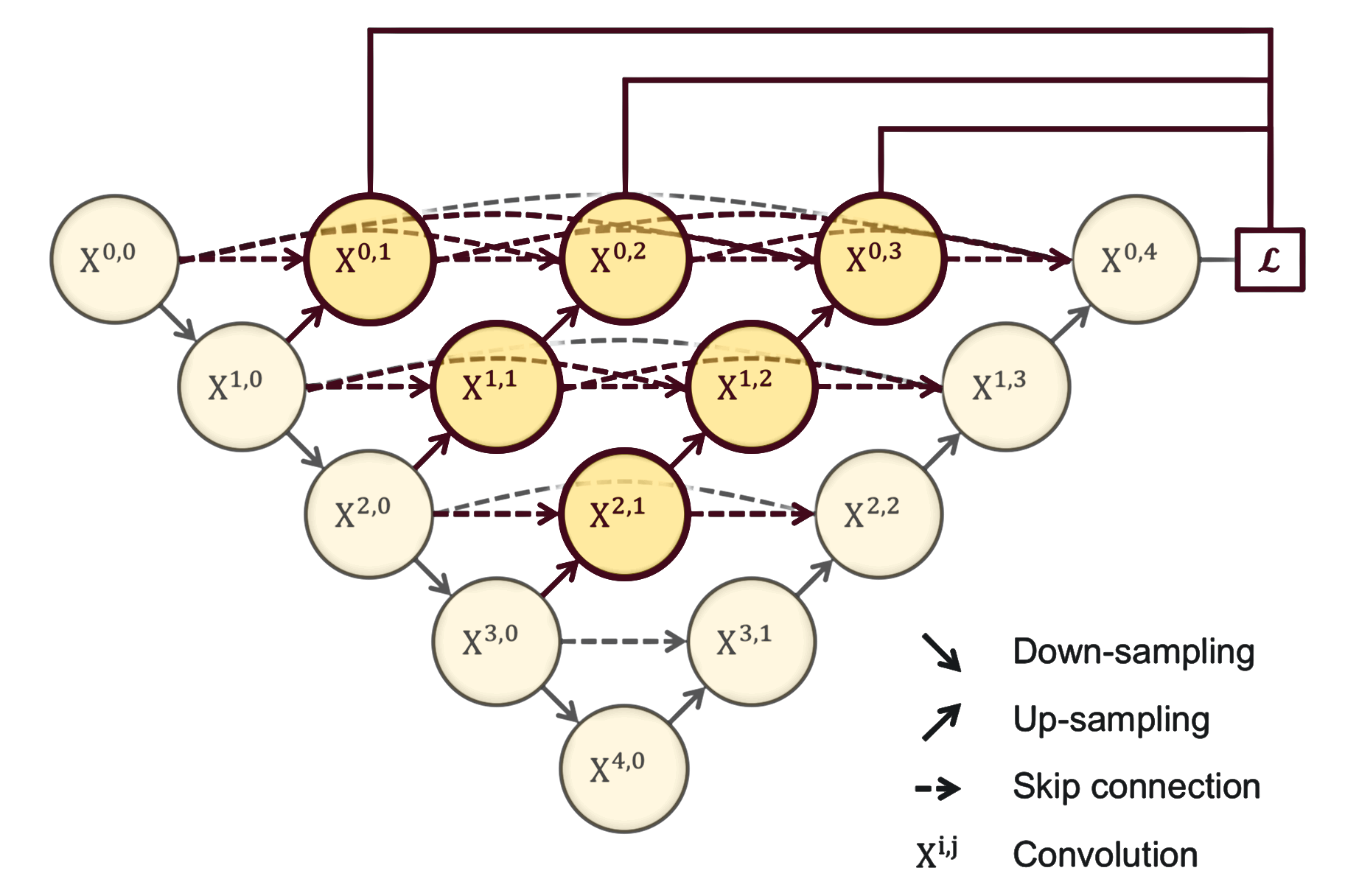
Designing a CNN
45
Number of layers and units
Start small and gradually increase the model size
Smallest model: linear regression
Deeper better than wider
Skip connections to avoid the problem of vanishing gradients, by reusing activations from a previous layer until the adjacent layer learns its weights
UNet++
Aims to address the unknown depth of the optimal UNet architecture and restrictions in the design of its skip connections. E.g. of its application:
Deep learning-based model for detecting 2019 novel coronavirus pneumonia on high-resolution computed tomography: a prospective study
Notes:
Here are some tips in designing a CNN. Start small and gradually increase the model size → smaller networks lead to better generalisation but smaller networks are harder to train with local methods such as Gradient Descent: It’s clear that their loss functions have relatively few local minima, but it turns out that many of these minima are easier to converge to, and that they are bad (i.e. with high loss). Conversely, bigger neural networks contain significantly more local minima, but these minima turn out to be much better in terms of their actual loss.
The example shown claimed to achieve a per-patient sensitivity of 100%, specificity of 93.55%, accuracy of 95.24%, PPV of 84.62%, and NPV of 100%; a per-image sensitivity of 94.34%, specificity of 99.16%, accuracy of 98.85%, PPV of 88.37%, and NPV of 99.61% in retrospective dataset. For 27 prospective patients, the model achieved a comparable performance to that of an expert radiologist with much shorter reading time (41.34s [IQR 39.76-44.48] vs. 115.50s [IQR 85.69-118.17] per patient).

Slide 46
Designing a CNN
46
Explaining vanishing gradients
Cost (Loss L) function
is an approximation of how wrong our predictions are relative to the target outcome. E.g. Mean Squared Error (MSE)
MSE = Sum [ ( Prediction - Actual )² ] * (1 / num_observations)
Gradient descent optimisation
is the way NN navigate the “space” to minimise these errors by modifying the weights until a good prediction is reached through backpropagation
Choose an initial vector of parameters w and learning rate η.
Repeat until an approximate minimum is obtained:
Randomly shuffle examples in the training set.
for i =1 to n
w = w − η ∇ L _{i} (w)
each weight receives an update proportional to the partial derivative of the error function with respect to the current weight in each training iteration.
Gradient descent, how neural networks learn | Deep learning, chapter 2 (21 mins)
What is backpropagation really doing? | Deep learning, chapter 3 (13.53 mins)
Notes:
We cannot calculate the perfect weights for a neural network; there are too many unknowns. Instead, the problem of learning is cast as a search or optimization problem and an algorithm is used to navigate the space of possible sets of weights the model may use in order to make good or good enough predictions.
Typically, a neural network model is trained using the stochastic gradient descent optimization algorithm and weights are updated back-propagating the error.
The “gradient” in gradient descent refers to an error gradient. The model with a given set of weights is used to make predictions and the error for those predictions is calculated.
The gradient descent algorithm seeks to change the weights so that the next evaluation reduces the error, meaning the optimization algorithm is navigating down the gradient (or slope) of error.

Slide 47
Designing a CNN
47
Cost function vs activation function
Smallest model
Predict a real (outcome) value
Activation function: linear (single unit output layer)
Loss function: Mean Squared Error (MSE)
Classify a lesion/image of belonging to 1 class (given 2 classes)
Activation function: sigmoid (single unit output layer)
Loss function: Cross-Entropy
Classify a lesion/image of belonging to 1 class (given more than 2 classes)
Activation function: softmax (output layer with one node for each class)
Loss function: Cross-Entropy
Regression
Binary Classification
Multi-class Classification

Slide 48
Designing a CNN
48
Cost function vs activation function
patternnet(hiddenlayersize,activationfunction,costfunction);
Classify a lesion/image of belonging to 1 class (given 2 classes)
Activation function: sigmoid (single unit output layer)
Loss function: Cross-Entropy
Classify a lesion/image of belonging to 1 class (given more than 2 classes)
Activation function: softmax (output layer with one node for each class)
Loss function: Cross-Entropy
Binary Classification
Multi-class Classification

Slide 49
Designing a CNN
49
functions to create the different types of layers
Templates for intermediate and output layers
function checkLayer checks validity of the layer
nnU-Net: Self-adapting Framework for U-Net-Based Medical Image Segmentation
Publication (https://www.nature.com/articles/s41592-020-01008-z )
Code (github)

Slide 50

Designing a CNN
50
Number of layers and units
Kernel size
3x3 and 1x1 (usually work best)
Not just a number, but channel-wise dense layers useful to learn cross-channel features
Don’t learn spatial info and don’t increase size of the receptive field but
a) combined with 3x3 filters can make good models
b) can be used for dimensionality reduction
64 units
1x1 filters
128 units
3x3 filters
=
32x32x256
32x32x64
32x32x128

Slide 51
Designing a CNN
51
Number of layers and units
Kernel size
3x3 and 1x1
a) combined with 3x3 filters can make good models
b) can be used for dimensionality reduction
64 units
1x1 filters
128 units
3x3 filters
=
32x32x64
32x32x128
32x32x256
32x32x256x1x1x64+32x32x64x128x3x3 = 92M computations
256x1x1x64+64x128x3x3 = 90,112 parameters
128 units
3x3 filters
=
32x32x256x128x3x3 = 300M computations
256x128x3x3 = 294,912 parameters

Slide 52
Designing a CNN
52
Number of layers and units
Kernel size
Sliding window step size (stride)
1 preserves the spatial resolution
2 downsample without using pooling

Slide 53
Designing a CNN
53
Number of layers and units
Kernel size
Sliding window step size (stride)
Pooling
Downsample feature maps by summarizing the presence of features in patches of the feature map.
average pooling summarises the average presence of a feature
max pooling indicates the most activated presence of a feature
max pooling
pooling size 2x2 (i.e. size of the patches)
same padding
Pooling layers for convolutional neural networks
Notes:
Convolutional layers in a convolutional neural network summarize the presence of features in an input image.
A problem with the output feature maps is that they are sensitive to the location of the features in the input. One approach to address this sensitivity is to downsample the feature maps. This has the effect of making the resulting downsampled feature maps more robust to changes in the position of the feature in the image, referred to by the technical phrase “local translation invariance.”
Downsampling can be achieved with convolutional layers by changing the sliding window or stride. But a more robust approach is to use pooling layers, which normally are added after each convolutional layer.
Pooling layers provide an approach to downsampling feature maps by summarizing the presence of features in patches of the feature map. Two common pooling methods are average pooling and max pooling that summarize the average presence of a feature and the most activated presence of a feature respectively.

Slide 54

Designing a CNN
54
Number of layers and units
Kernel size
Sliding window step size (stride)
Pooling
Activation and costs function
ReLU except for output layer

Slide 55
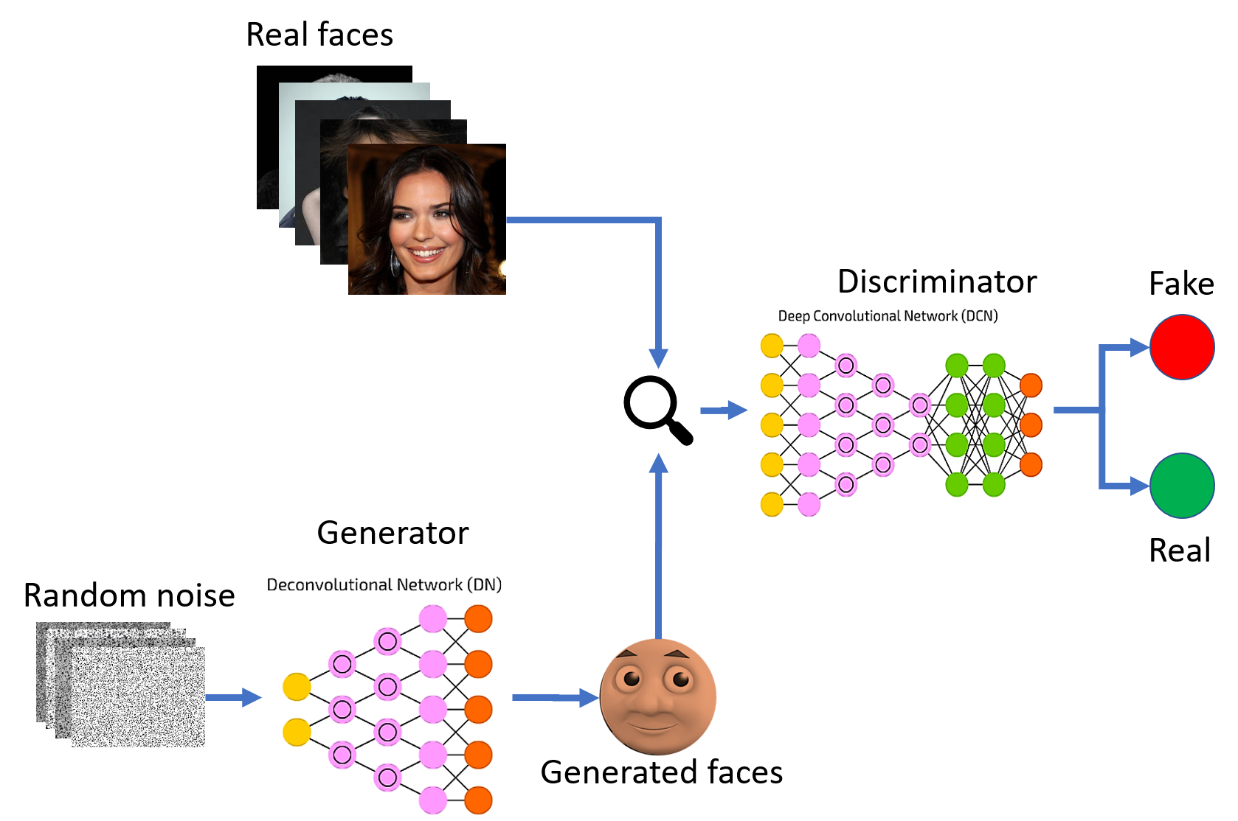
Generative Adversarial Networks
55
Image source (accessed on 02/03/2022)
https://d18rbf1v22mj88.cloudfront.net/wp-content/uploads/sites/3/2018/03/29200233/GAN_en.png
Notes:
GANs are generative models that work on the principle of generating and discriminating the inputs. The two networks: generator and discriminator go toe to toe with each other benefitting the overall model.

Slide 56
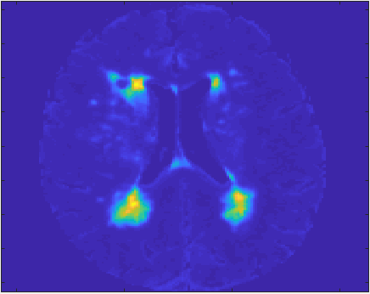
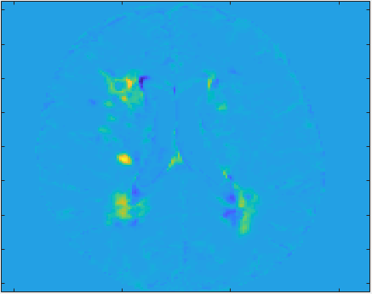
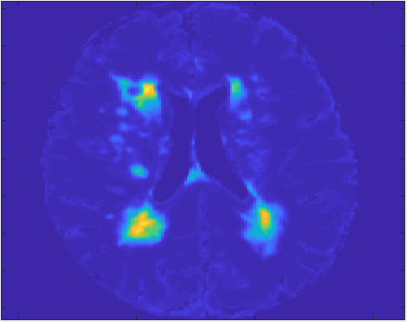


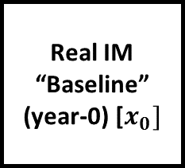


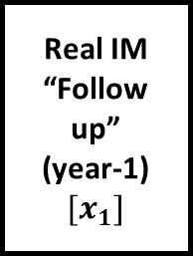
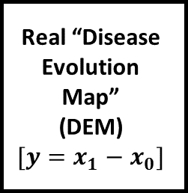
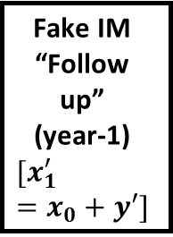

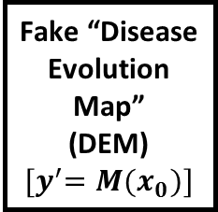

DEP-GAN
56
IM 1st year
IM y2 – IM y1
IM 2nd year
MIMIC
MIMIC
Real IM “Baseline”
(year-0) [$x_{0}]$
Fake “Disease
Evolution Map”
(DEM)
$${{[y}^{′}=M(x}_{0})]$$
Fake IM
“Follow up”
(year-1)
$$[x_{1}^{′}=x_{0}+y′]$$
Real IM
“Follow up”
(year-1) $[x_{1}]$
$$M(x)$$
Moderator
Block
Real “Disease
Evolution Map”
(DEM)
$$[y=x_{1}−x_{0}]$$
$$C(x)$$
$$D(x)$$
Random Noises
$$3×3$$
Conv.
$$3×3$$
Conv.
BN
$$γ_{M}^{N},β_{M}^{N}$$
BN
ReLU
ReLU
Real/Generated
Real/Generated
https://link.springer.com/chapter/10.1007/978-3-030-32248-9_17
Notes:
We have used GANs to predict the evolution of white matter hyperintensties from one year to another (i.e. Year 1 to year 2), using the “irregularity map” generated using the FLAIR image, which gives high granularity in representing the abnormalities in tissue. The screen shows the Disease Evolution Predictor (DEP) scheme using GANs. As training progresses, the generator starts to output images that look closer to the images from the training set. This happens because the generator tries to learn the data distribution of the training set images.

Slide 57






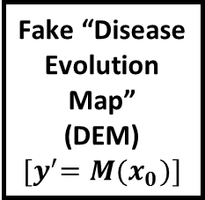



DEP-GAN
57
To accommodate non-deterministic characteristic of WMH evolution (i.e., unknown reasons that cause progression/regression), we proposed additional randomness to the latent representation of function $M\left(x\right)$ (see yellow boxes).
Gaussian noise ($z \sim N(0,1)$) is first encoded using convolutional layers and then modulated using Feature-wise Linear Modulation (FiLM) layer.
Real IM “Baseline”
(year-0) [$x_{0}]$
Fake “Disease
Evolution Map”
(DEM)
$${{[y}^{′}=M(x}_{0})]$$
Fake IM
“Follow up”
(year-1)
$$[x_{1}^{′}=x_{0}+y′]$$
Real IM
“Follow up”
(year-1) $[x_{1}]$
$$M(x)$$
Real “Disease
Evolution Map”
(DEM)
$$[y=x_{1}−x_{0}]$$
$$C(x)$$
$$D(x)$$
Random Noises
$$3×3$$
Conv.
$$3×3$$
Conv.
BN
$$γ_{M}^{N},β_{M}^{N}$$
BN
ReLU
ReLU
Real/Generated
Real/Generated
https://link.springer.com/chapter/10.1007/978-3-030-32248-9_17

Slide 58
Validation
58
Cross-validation
Spatial agreement (Jaccard / Dice plotted against mean volume between result and ground truth)
Volumetric agreement (Plot of percentage difference between result and ground truth with respect to their mean vs. mean volume)
Bland –Altman plot

Slide 59
Validation
59
Cross-validation
Spatial agreement (Jaccard / Dice plotted against mean volume between result and ground truth)
Volumetric agreement (Plot of percentage difference between result and ground truth with respect to their mean vs. mean volume)
Construct linear regression models involving the measurement of the parameter in question (e.g. lesion volume) and clinical and demographic factors known relate to it (e.g. vascular risk factors and age) and compare the results of the model (i.e. strength and significance of the associations) using the ground truth vs. using the results from the deep learning scheme
Bland –Altman plot

Slide 60
Validation
60
Cross-validation
Spatial agreement (Jaccard / Dice plotted against mean volume between result and ground truth)
Volumetric agreement (Plot of percentage difference between result and ground truth with respect to their mean vs. mean volume)
Construct linear regression models involving the measurement of the parameter in question (e.g. lesion volume) and clinical and demographic factors known relate to it (e.g. vascular risk factors and age) and compare the results of the model (i.e. strength and significance of the associations) using the ground truth vs. using the results from the deep learning scheme
Use Kruskal-Wallis (more than 2 variables) or Mann-Whitney-U test to compare volumetric results between ground truth and deep learning outcome
Bland –Altman plot

Slide 61
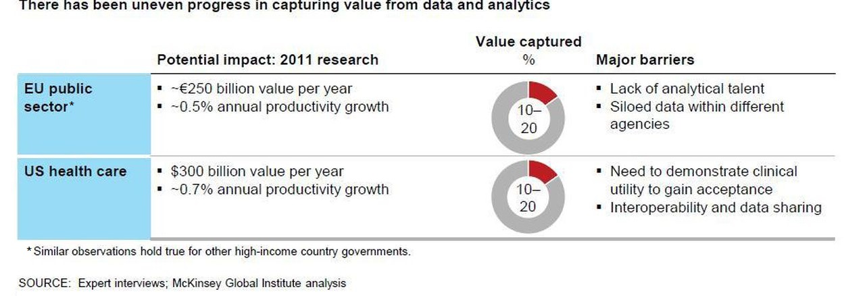
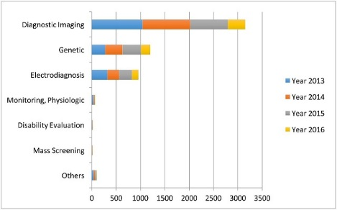
Deep learning value and major barriers
61
Invariance of translations
Multiscale hierarchy
Very flexible models
Increase in computing power
Efficient inference engine
Powerful priors
Exploit compositionality (as human languages) to give representations and meanings to complex ideas
Exponential gain in representational power

Slide 62
Advances in Deep Learning Research
62
MIDL (Medical Imaging with Deep Learning)
  MIDL 2018 Selected Papers
MIDL 2019 Proceedings
MIDL 2020 Proceedings
MIDL 2021 Proceedings
MICCAI Conference proceedings
Medical Image Analysis (journal Elsevier)
IEEE Transactions in Medical Imaging
Frontiers (journals)
Computerized Medical Imaging and Graphics (journal Elsevier)
IEEE Transactions on Neural Networks and Learning Systems

Slide 63
Our Publications
63
Evaluation of Enhanced Learning Techniques for Segmenting Ischaemic Stroke Lesions in Brain Magnetic Resonance Perfusion Images using a Convolutional Neural Network Scheme
Dilated Saliency U-Net for White Matter Hyperintensities Segmentation using Irregularity Age Map
Segmentation of white matter hyperintensities using convolutional neural networks with global spatial information in routine clinical brain MRI with none or mild vascular pathology
Deep learning vs. conventional machine learning: Pilot study of WMH segmentation in brain MRI with absence or mild vascular pathology
Automatic Spatial Estimation of White Matter Hyperintensities Evolution in Brain MRI using Disease Evolution Predictor Deep Neural Networks
Predicting the Evolution of White Matter Hyperintensities in Brain MRI using Generative Adversarial Networks and Irregularity Map
Evaluation of Four Supervised Learning Schemes in White Matter Hyperintensities Segmentation
White matter hyperintensity and stroke lesion segmentation and differentiation using convolutional neural networks

Slide 64




Thank you!

