Slide 1
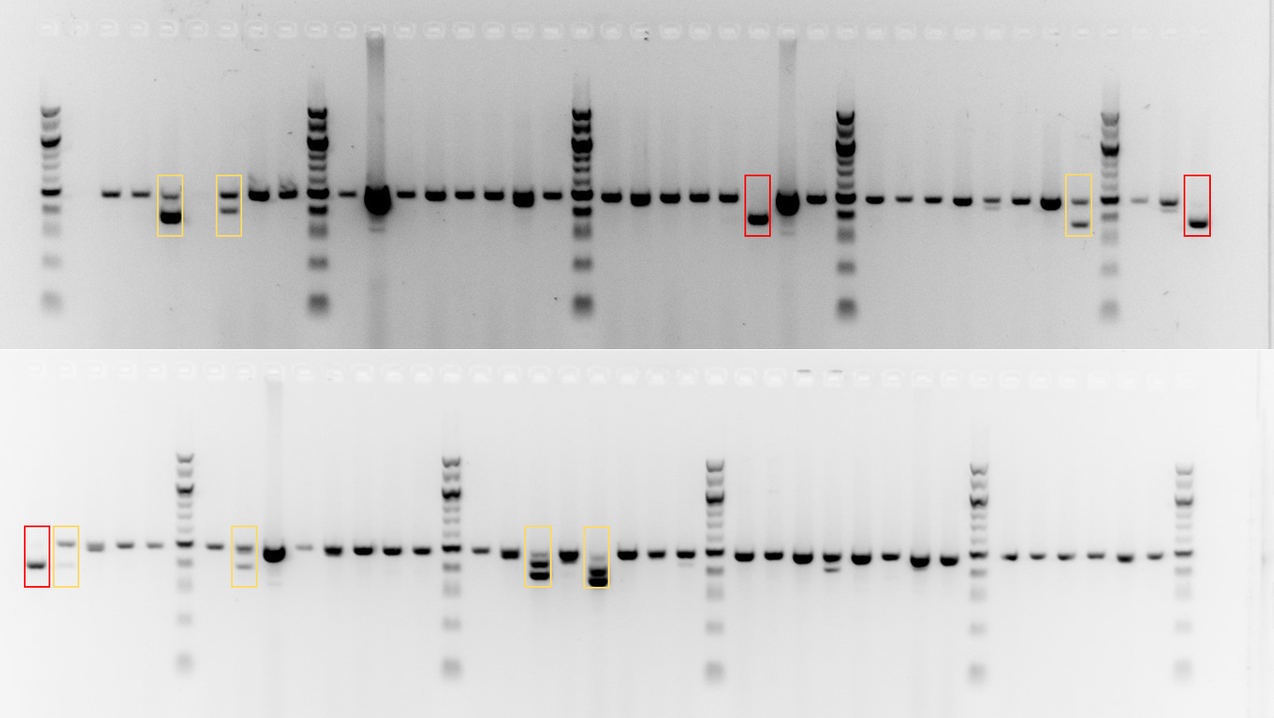
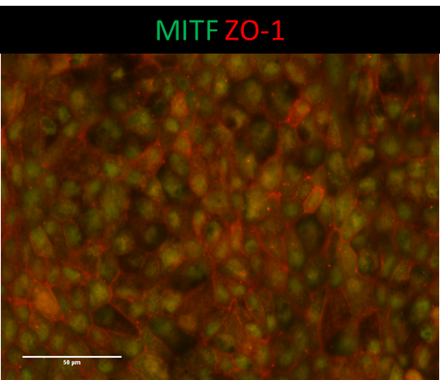
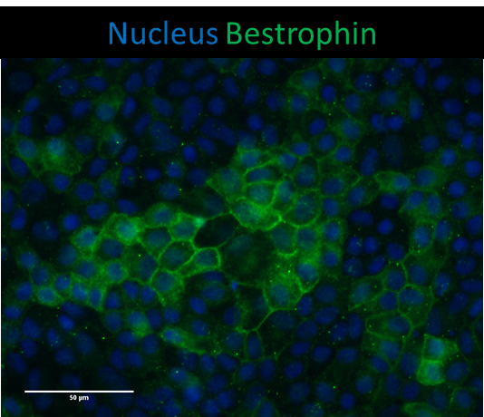
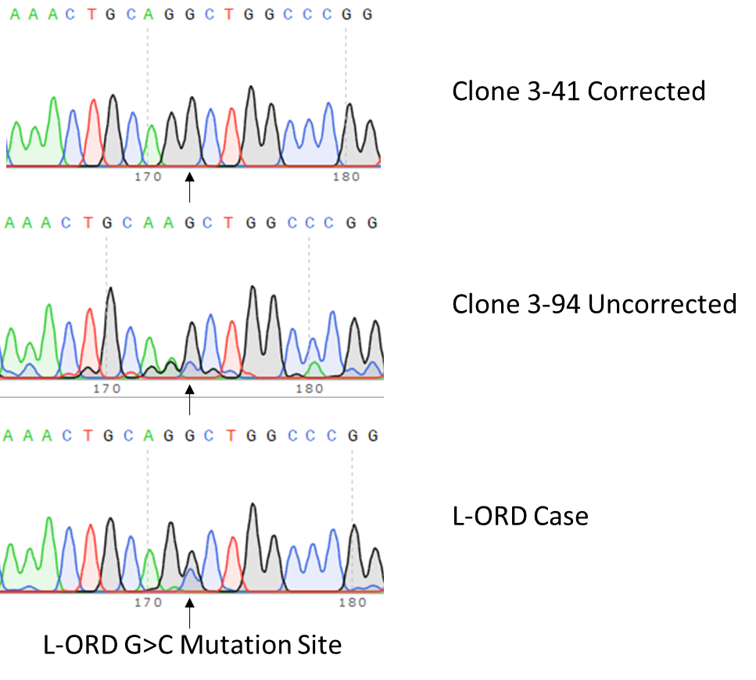
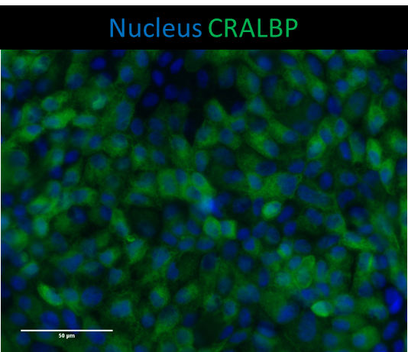
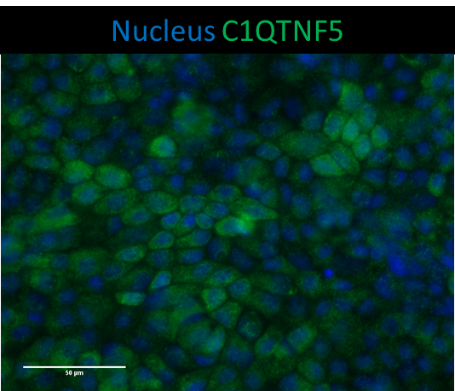
Establishing a model for macular degeneration using CRISPR-Cas9 gene editing and human induced pluripotent stem cells
A Neiteler^{1,2,3,5}, S Borooah⁶, BT Selvaraj^{2,3,5}, K Burr^{2,3,5}, B Dhillon^{2,4}, JA Ross¹, S Chandran^{2,3,5}
¹Tissue Injury and Repair Group, ²Centre for Clinical Brain Sciences, ³Euan MacDonald Centre, ⁴Ophthalmology, School of Clinical Sciences, University of Edinburgh, 49 Little France Crescent, Edinburgh EH16 4SB, UK
⁵MRC Centre for Regenerative Medicine, University of Edinburgh, 5 Little France Drive, Edinburgh EH16 4UU, UK
⁶Shiley Eye Institute, University of California, San Diego, 9415 Campus Point Drive, La Jolla, CA 92093, USA
Introduction
Late-onset retinal degeneration (L-ORD) is a rare autosomal dominant inherited retinal degeneration and shares similar phenotypic and pathologic characteristics with age-related macular degeneration (AMD). L-ORD results from a p.S163R mutation in the gene C1QTNF5. Previously, we derived human induced pluripotent stem cells (hiPSCs) from patients with L-ORD. To further asses the L-ORD C1QTNF5^{S163R} mutation, we show the gene correction of this mutation in a patient-derived hiPSC line using CRISPR-Cas9 to establish an isogenic control To further asses the function of C1QTNF5, we also generated a C1QTNF5 null hiPSC line using CRISPR-Cas9 Retinal pigment epithelial (RPE) cells that we derive from iPSCs express characteristic RPE markers, as well as C1QTNF5.
Gene knockout of C1QTNF5
A
B
C
Gene correction of C1QTNF5
A
Figure 2. Gene knockout of C1QTNF5. (A) CRISPR-Cas9 gene editing strategy. (B) Clone screen using PCR. (C) Sequencing results.
B
C1QTNF5 expression in iPSC-RPE
A
B
C
C
D
Figure 3. Expression of RPE markers and C1QTNF5 in hiPSC-RPE. Immunocytochemistry of control hiPSC-RPE showing expression of (A) MITF and ZO-1, (B) Bestrophin, (C) CRALBP, and (D) C1QTNF5.
Figure 1. Gene correction of L-ORD hiPSCs. (A) CRISPR-Cas9 gene editing strategy. (B) Clone screen using restriction fragment length polymorphism. (C) Sequencing results.
Conclusion
We successfully corrected the L-ORD C1QTNF5^{S163R} mutation in patient-derived hiPSCs using CRISPR-Cas9 We successfully generated a hiPSC C1QTNF5 knockout line using CRISP-Cas9 to assess C1QTNF5 function We successfully differentiated hiPSCs to hiPSC-RPE that express typical RPE markers, as well as C1QTNF5

