Slide 1


Vevo Strain Software: Multifunctional cardiac analysis
Mr Adrian Thomson

Slide 2
Vevo Strain Software: Multifunctional cardiac analysis
Recommended introduction online tutorials and user guide
Visualsonics Vevo strain software
https://www.visualsonics.com/product/software/vevo-strain-software
April 2015 Webinar - On Demand Tutorial: How to Measure Cardiac Wall Strain
https://www.youtube.com/watch?v=aC4dNaDh9og
Oct 2017 VevoStrain Webinar - Understanding Subtle Cardiac Changes
https://www.youtube.com/watch?v=qdr9Z0itTdo&t=2670s
Visualsonics 51064 Vevo Strain User Guide 1.1

Slide 3
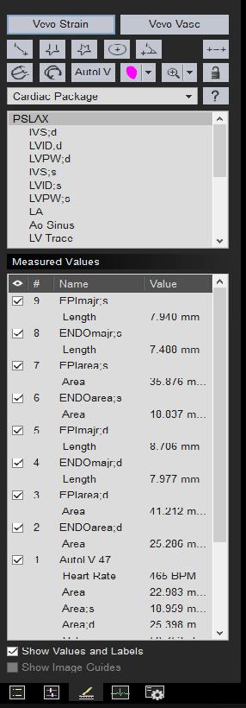
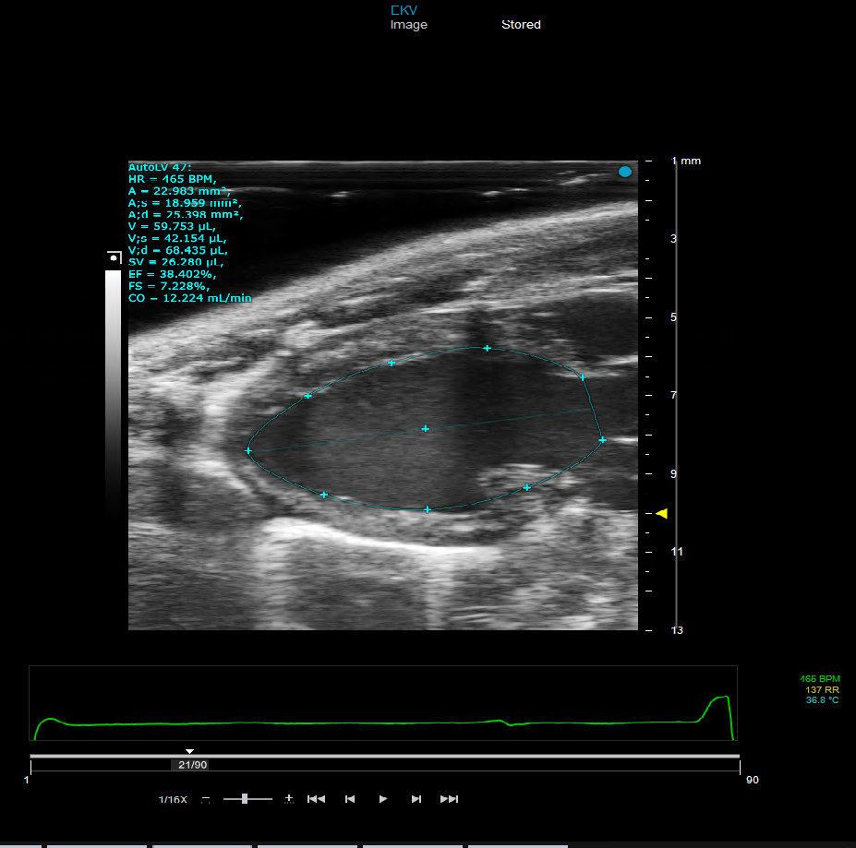
Vevo Strain Software: Multifunctional cardiac analysis
Choose a good EKV and first press Auto LV for functional measurements
Press Vevo strain to start vevo strain software

Slide 4
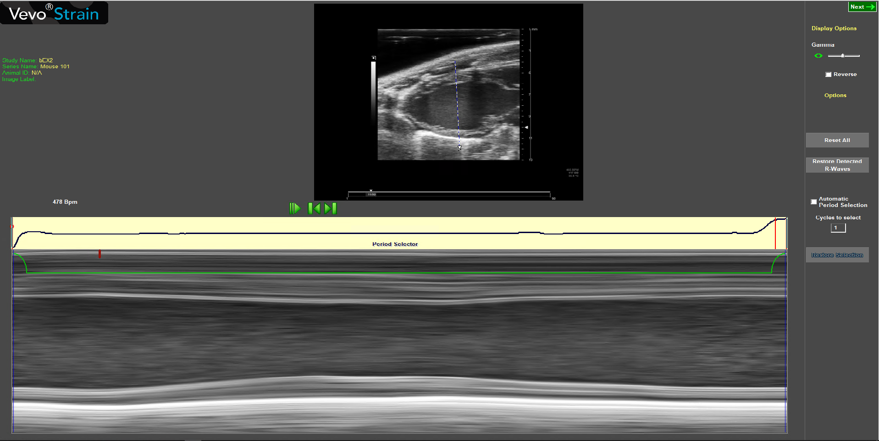
Vevo Strain Software: Multifunctional cardiac analysis
Draw line across LV to select mmode
Press to select whole cardiac cycle R-R in period selector for analysis
Press next

Slide 5
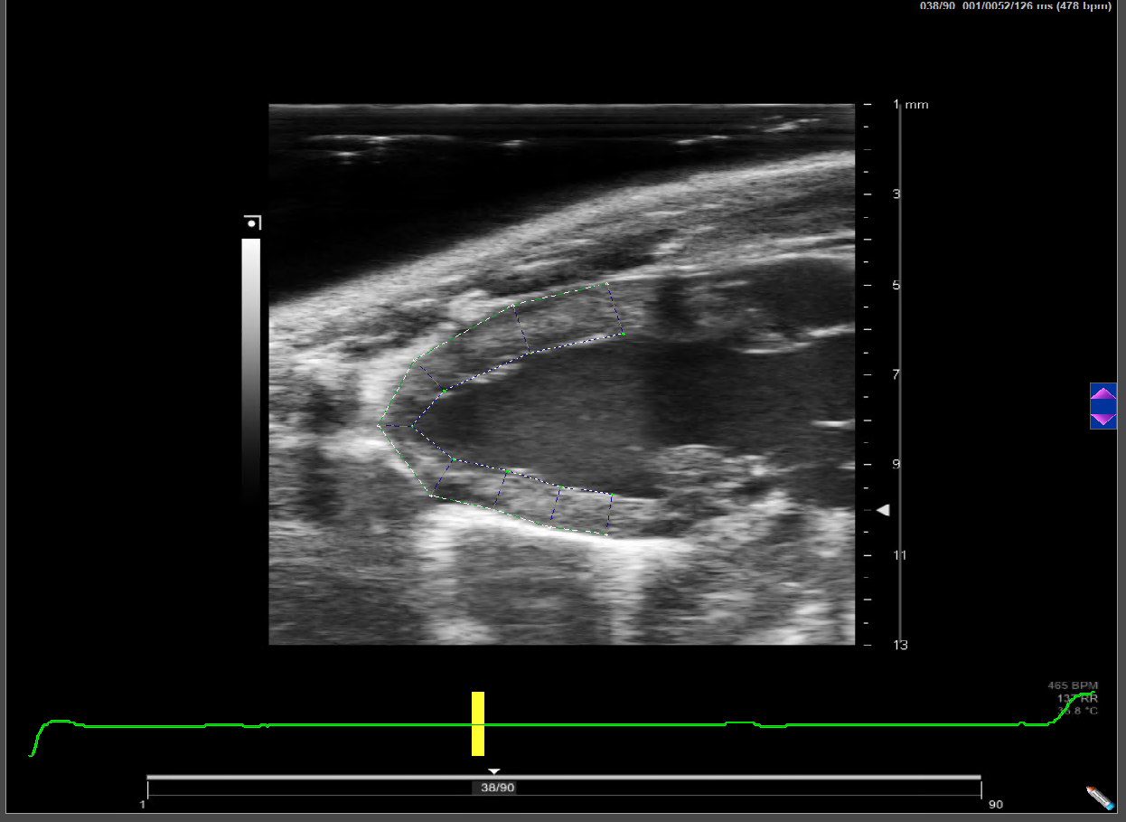
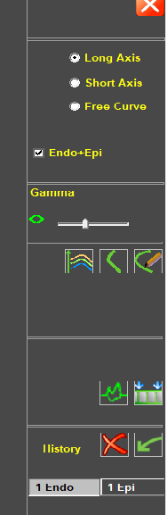
Vevo Strain Software: Multifunctional cardiac analysis
Press Long axis
Press Endo and Epi
Press Endo
Draw around LV Endocardium

Slide 6
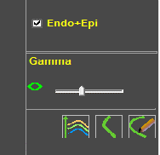
Vevo Strain Software: Multifunctional cardiac analysis
Trace around LV Endocardium with left mouse button, ensure not to include base level ,the software auto detects Epi press right button to select
Make corrections to wall trace if needed by selecting points on trace too delete or move (plus option max min trace size)
Press Start Analysis

Slide 7
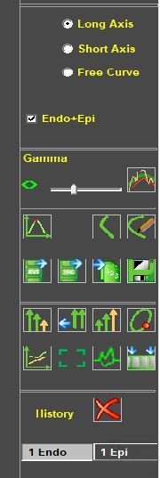
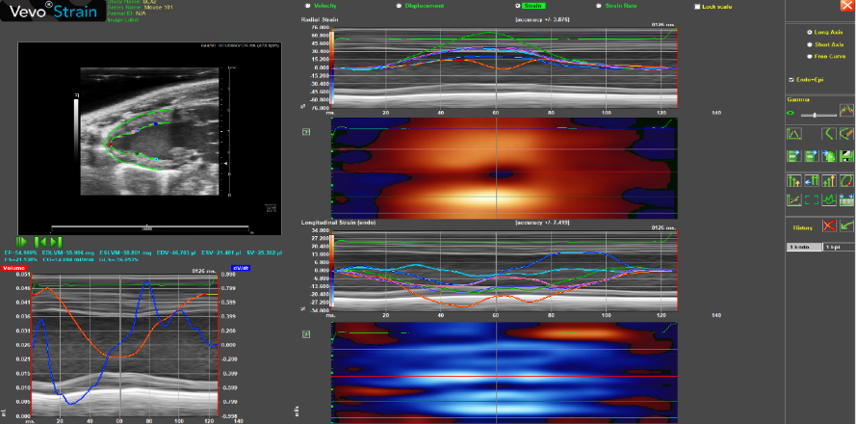
Vevo Strain Software: Multifunctional cardiac analysis
Review the bmode and edit trace
If needed

Slide 8
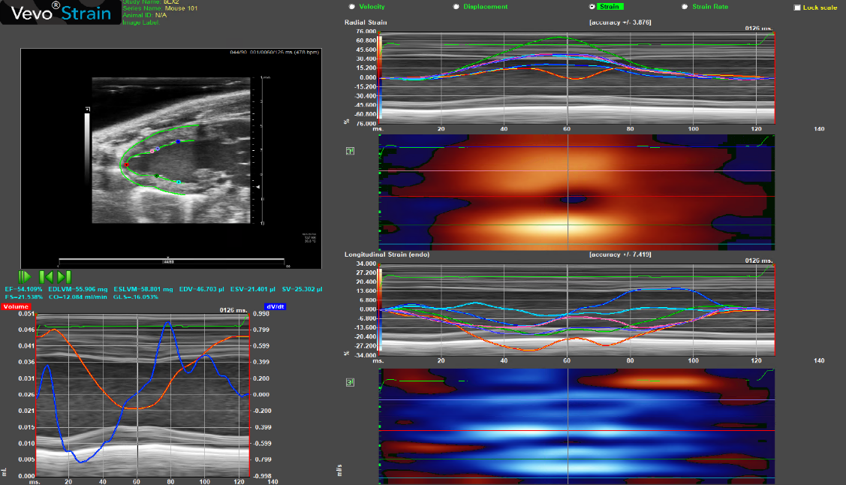
Vevo Strain Software: Multifunctional cardiac analysis
Analysis workspace
Radial strain is positive strain in systole hence red colour
Longitudinal strain is a negative strain in systole hence blue colour
Sub endocardial function is powered mostly by longitudinal contraction, it is impaired earlier than circumferential or radial component’s. Therefore, Longitudinal function is in most cases the best early marker of left ventricular dysfunction.
Different points on the trace can be selected on the bmode image and displayed across the cardiac cycle

Slide 9
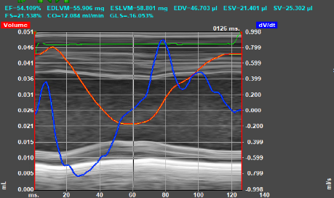
Vevo Strain Software: Multifunctional cardiac analysis
Analysis Workspace
Functional measurements can be obtained in vevo strain, but Auto LV using artificial intelligence via the vevo lab software is a more rebust method
The main measurement here is Global Longitudinal Strain (GLS) , similar to EF as a functional measurement , but more reproducible and detects subclinical myocardial dysfunction before LVEF (systolic)
Graph displays the volume and volume derivative/time derivative

Slide 10
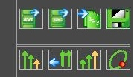
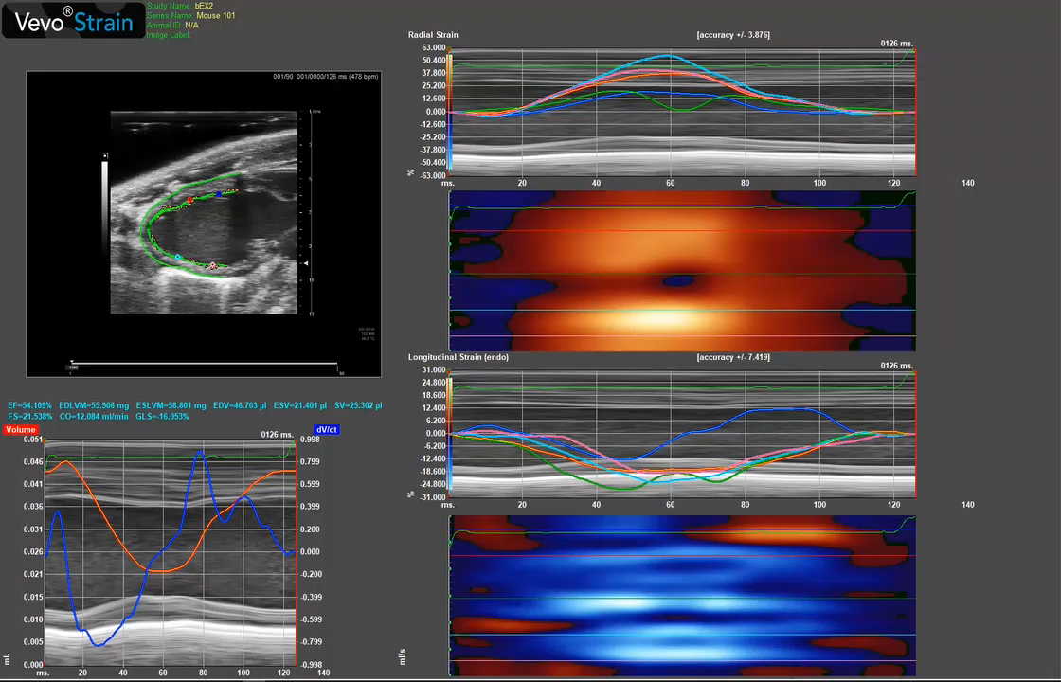
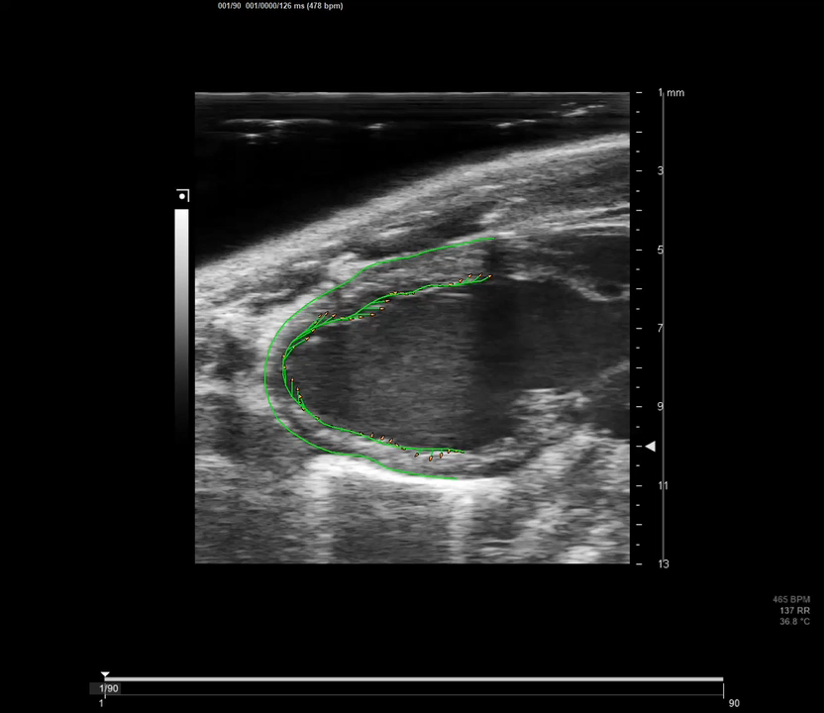
Vevo Strain Software: Multifunctional cardiac analysis
Data can be exported in excel format .
Plus Movie' and images can be exported of either bmode only or whole screen
Plus on the Bmode image there is an option to view the directional tendencies of the LV wall trace.
Vectors of degree of movement or orbital movement can be be displayed
Ben Thomas

Slide 11
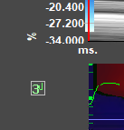
Vevo Strain Software: Multifunctional cardiac analysis
Press 3D button for a 3D illustrative representation of longitudinal strain .
Red positive strain diastolic
Blue negative strain systolic
X axis is time
Y axis is position or distance on the epi LV starting at the posterior base 0mm around to the anterior base 10mm.
Z axis is ( in this case ) strain %

Slide 12
Vevo Strain Software: Multifunctional cardiac analysis
Example of a 14D MI and Sham
SHAM MI
Dr Ana-Mishel Spiroski

Slide 13
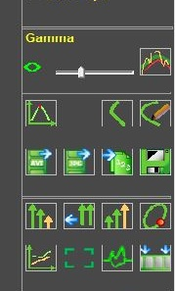
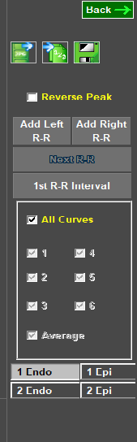
Vevo Strain Software: Multifunctional cardiac analysis
Time to Peak analysis
Press Back to return to analysis workspace.
And export data/ images with buttons below.
History – you can have more than one trace
Press Button for open Time to Peak (TPK) window

Slide 14
Vevo Strain Software: Multifunctional cardiac analysis
Time to Peak analysis
Time-to-Peak is calculated as the time from the reference axis, 0.000 (the Rwave is the reference point), to the maximum peak velocity, for
each of the segments of the heart.
The C pictographs show the TPK blue /low to red/high for each segment and the outer /inner border colours correspond with the lines on the mmode .
The phase measures the synchronicity between regions of the heart for a
selected time interval

Slide 15
Vevo Strain Software: Multifunctional cardiac analysis
Time to Peak analysis
Systolic Strain analysis
Strain or degree of deformation is expressed as a % (Pk%) and Strain Time to peak (TPK ms) is displayed in 6 segments but can also be averaged ( ignore the Aver.curve this is not an average of the segments)
Both Strain and strain TPK can be used to assess subtle systolic /contractile changes or acute MI models .
Plus the standard deviation of time to peak longitudinal strain across the 6 segment’s can be used to analyse dyssynchrony / mechanical dispersion in a MI model , also maybe a useful measurement in dilated cardiomyopathy .

Slide 16

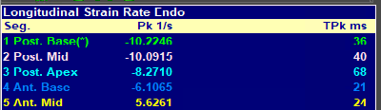

Vevo Strain Software: Multifunctional cardiac analysis
Time to Strain analysis
Systolic Strain Rate
Again Systolic Strain rate is negative
Strain rate or rate of strain/deformation ,ie change in strain per time unit /s, or Pk 1/s , and Strain rate Time to peak (TPK ms) is displayed in 6 segments but can also be averaged ( ignore the Aver.curve this is not an average of the segments)
Both Strain rate and strain rate TPK can be used to assess subtle systolic /contractile changes or acute MI models .

Slide 17
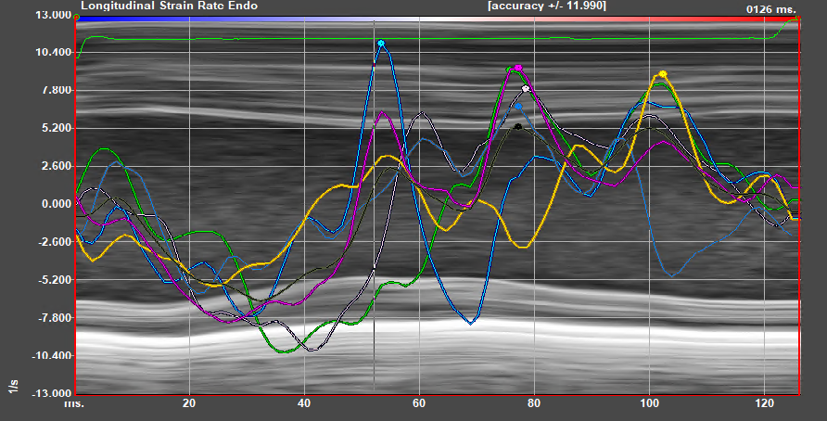
Vevo Strain Software: Multifunctional cardiac analysis
Time to Peak analysis
Diastolic Strain Rate
Diastolic Strain rate is Positive
Press Reverse Peak to select positive peaks
Diastolic-Reverse Longitudinal Strain Rate (rLSR)

Slide 18

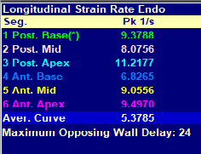
Vevo Strain Software: Multifunctional cardiac analysis
Time to Peak analysis
Diastolic-Reverse Longitudinal Strain Rate (rLSR)
Diastolic Strain Rate
Diastolic Strain rate is Positive
In Time To Peak analysis, six segmental sections of the longitudinal Left ventricle can be analysed for peak negative /diastolic strain rate , this is referred to as the reverse peak to differentiate from peak positive /systolic strain rate .
The average of the six regional segments is called “Reverse Longitudinal strain rate” (rLSR) is a sensitive global diastolic measurement.
Ignore the Aver.curve this is not an average of the segments)

Slide 19
Vevo Strain Software: Multifunctional cardiac analysis
Time to Peak analysis
The End

